Slide 1
Version control with Github Desktop
Shuai Wei
IS&T Boston University

Slide 2
Git

Slide 3
github.com

Slide 4
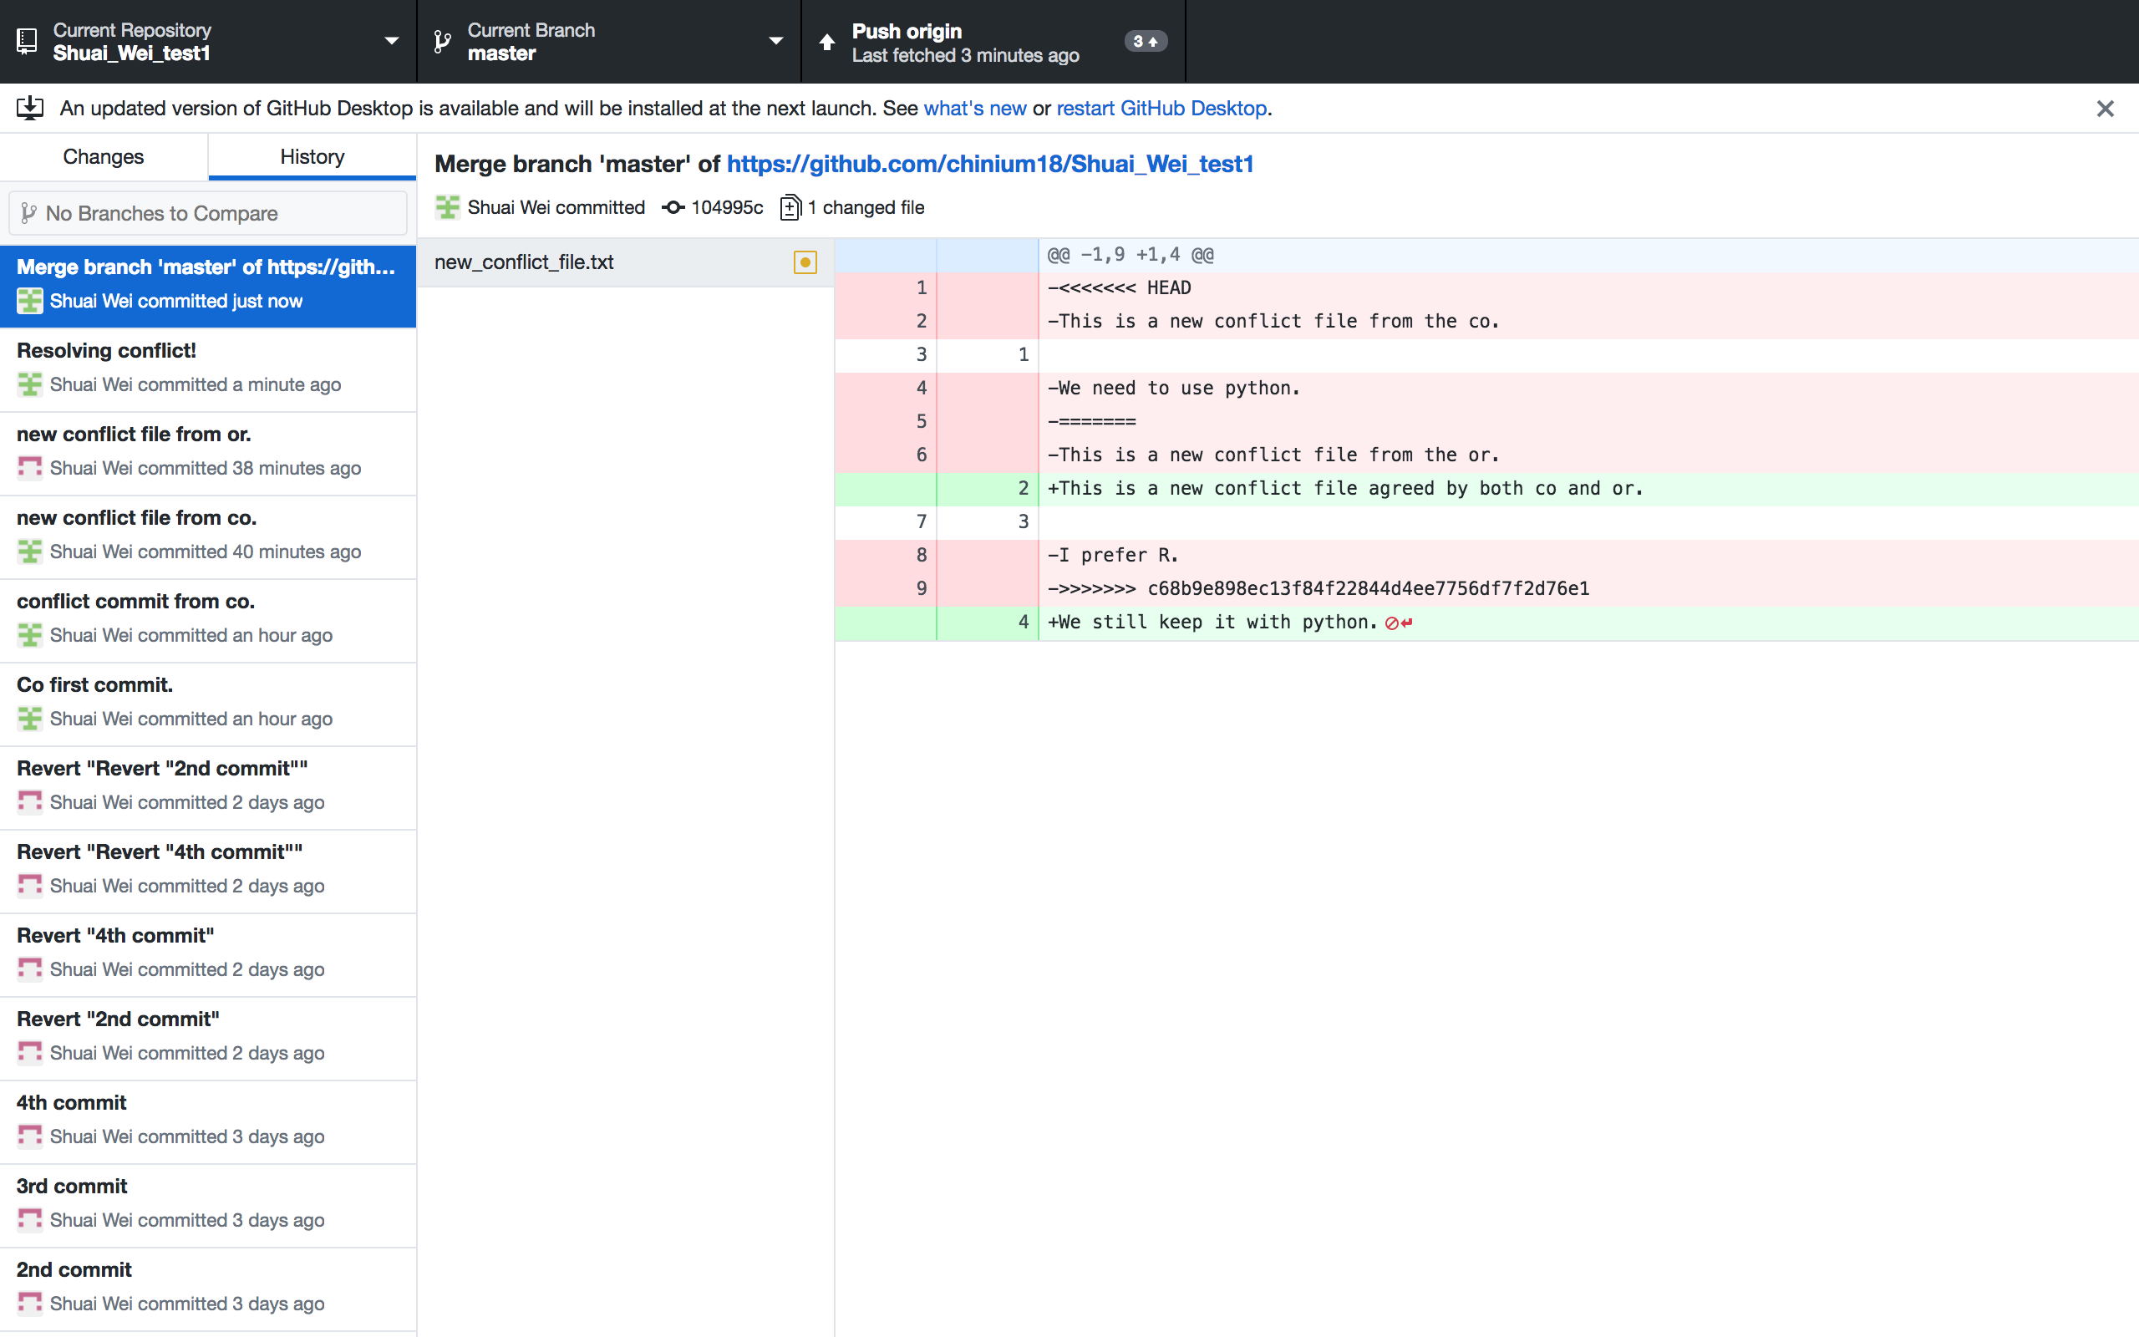
GitHub desktop
It’s a fast, easy way to contribute to projects from OS X and Windows.
GitHub workflow and replace GitHub for Mac and Windows with a unified experience across both platforms.

Slide 5
Setting up GitHub Desktop
Installing GitHub Desktop
https://desktop.github.com/
Authenticating to GitHub
Add your GitHub.com account information to GitHub Desktop
Configuring Git for GitHub Desktop
If you don’t have Git installed, you must configure it before using GitHub Desktop.

Slide 6
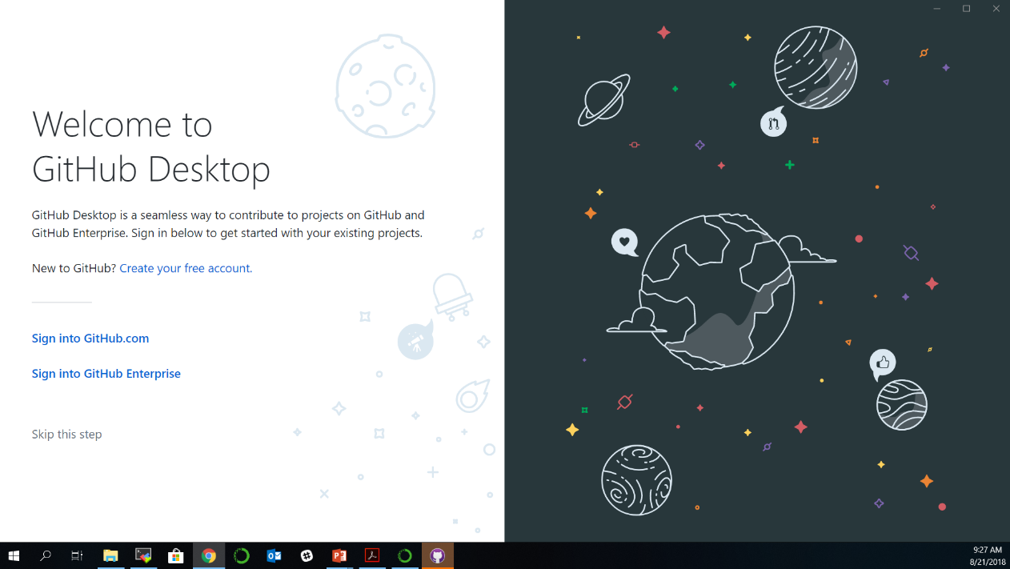
Authenticating to GitHub
or

Slide 7
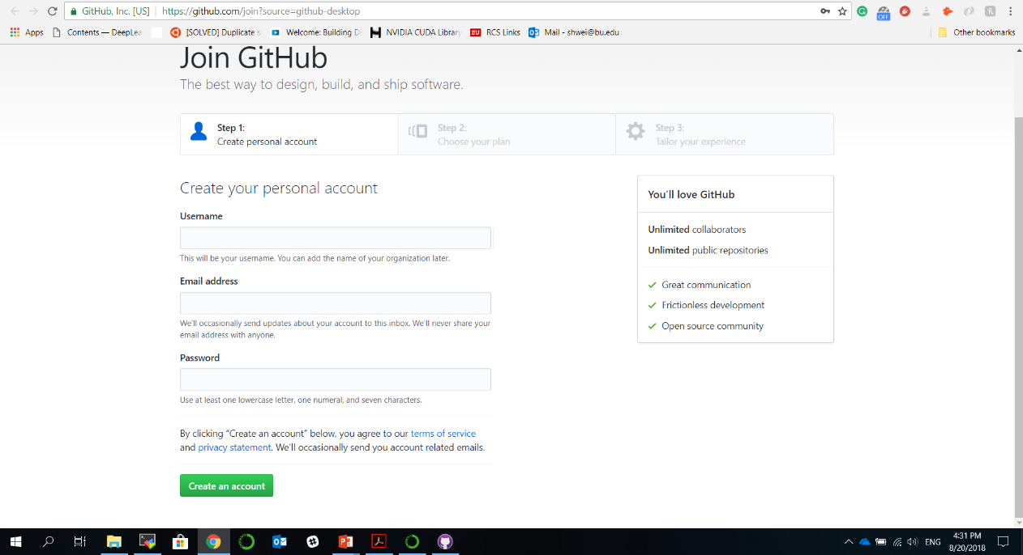
Creating GitHub account if you don’t have an account already

Slide 8
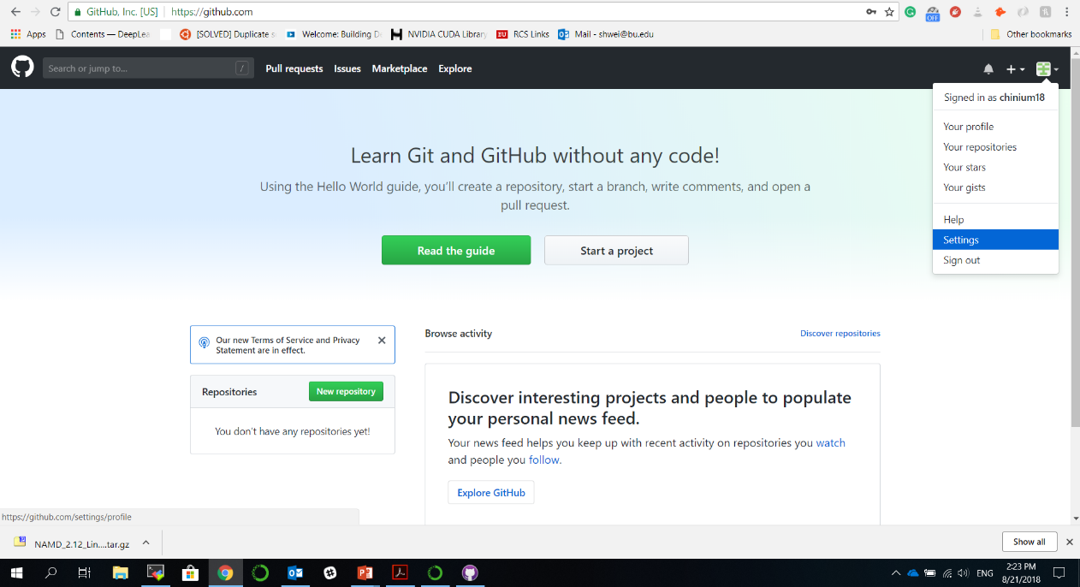
Configuring GitHub account

Slide 9
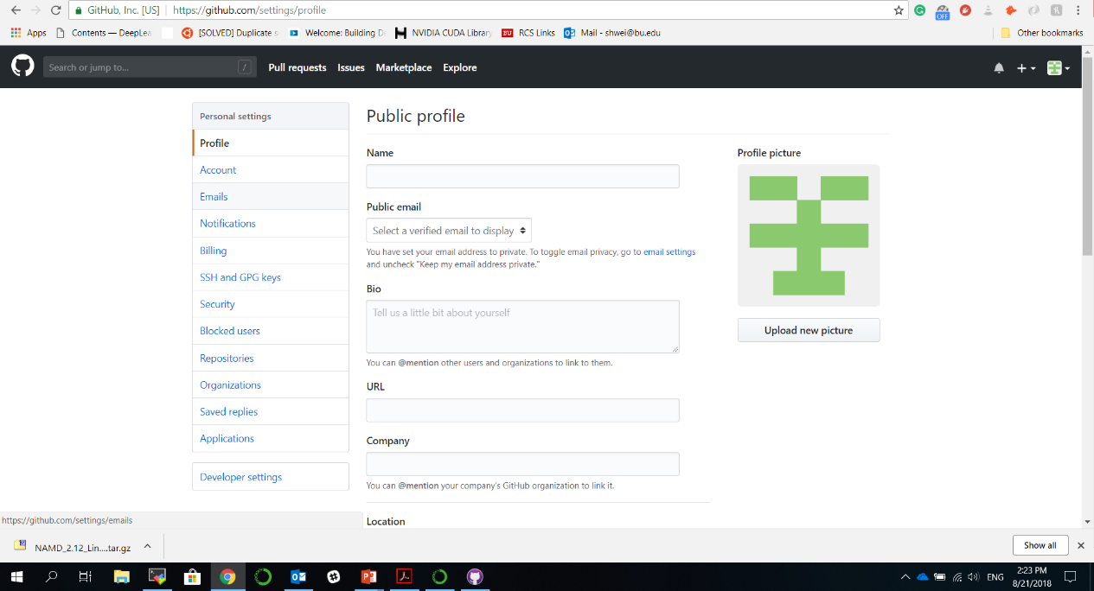
Configuring GitHub account

Slide 10
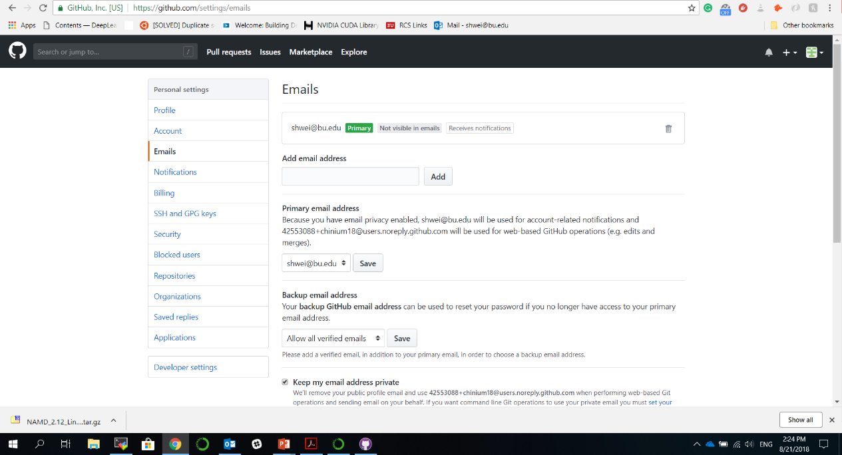
Configuring GitHub account

Slide 11
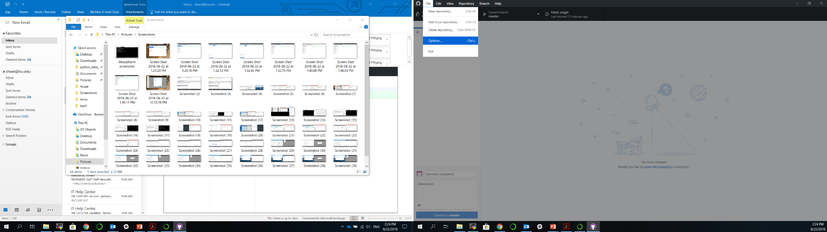
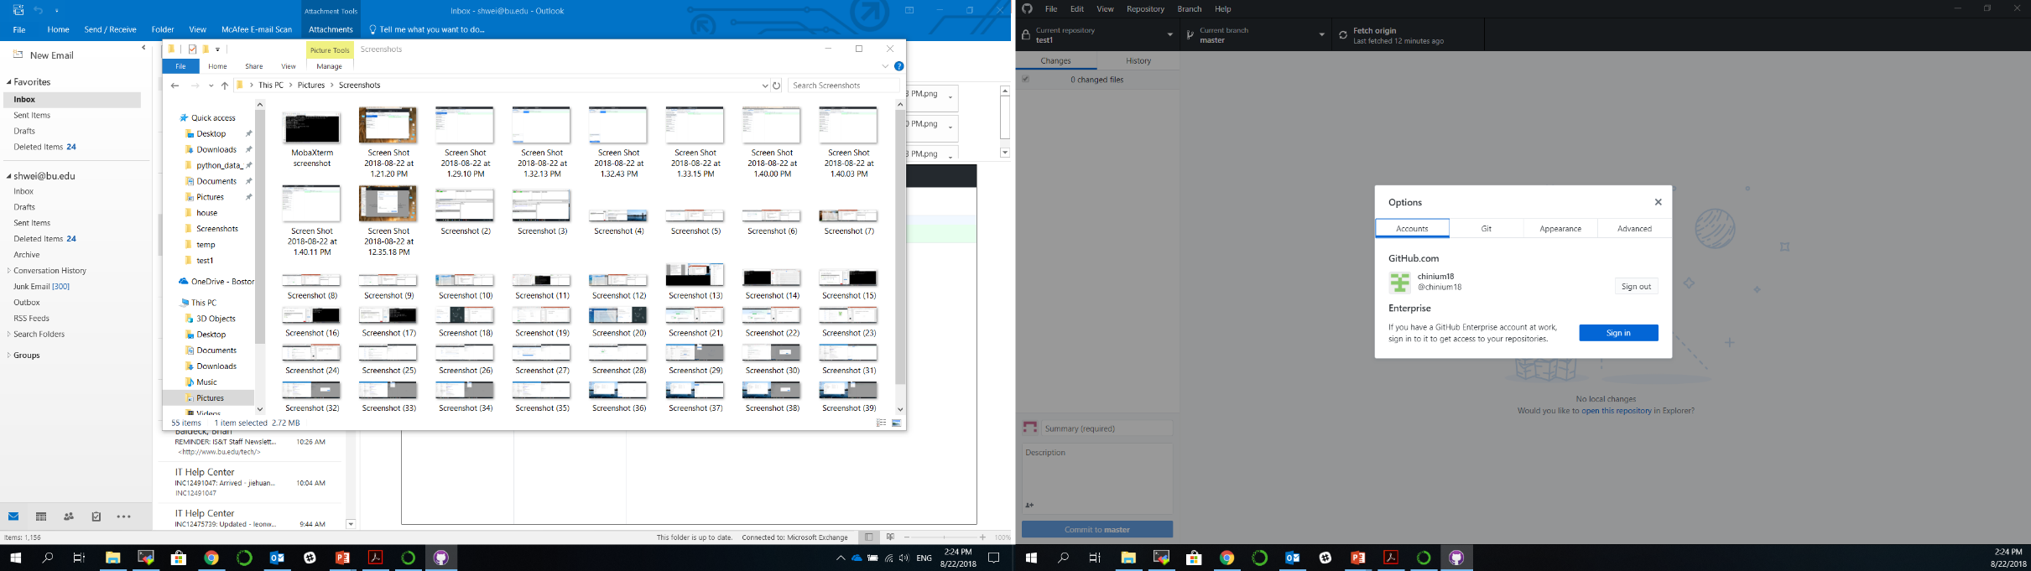
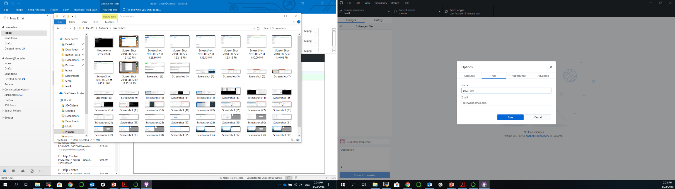
GitHub Desktop Setup

Slide 12
Using Github desktop for version control
Track and visualize each update of your code in the same repository.
Revert a previous version/commit.
Branch out for large project development.

Slide 13
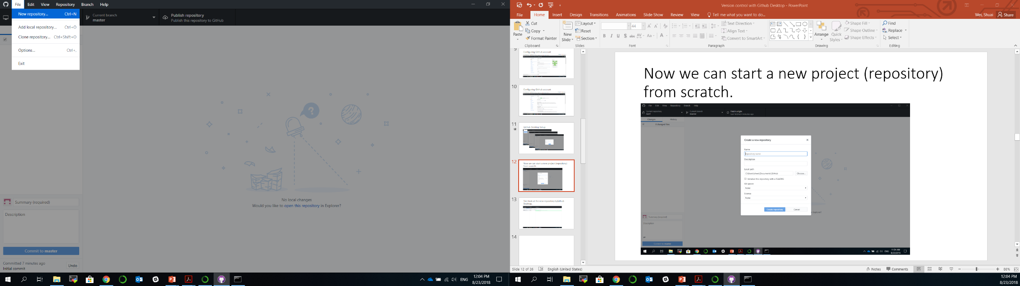
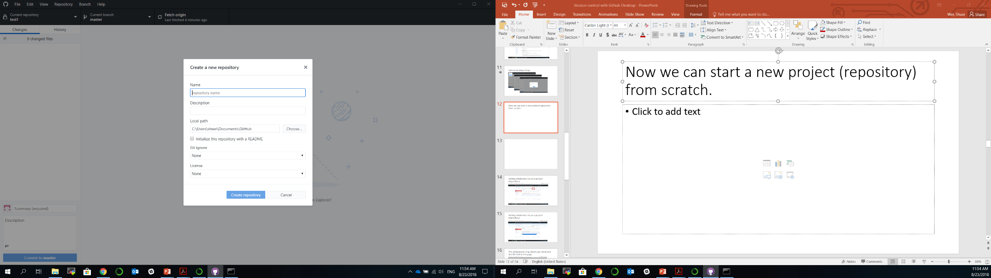
Now we can start a new project (repository) from scratch.

Slide 14
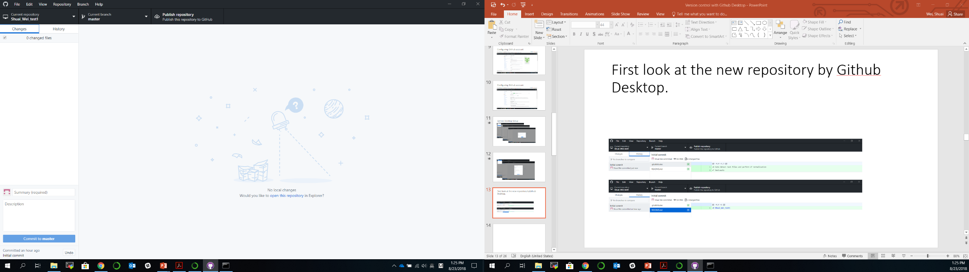
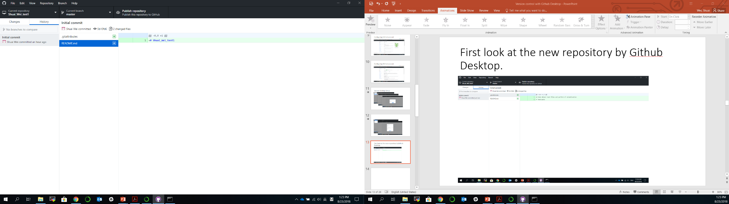
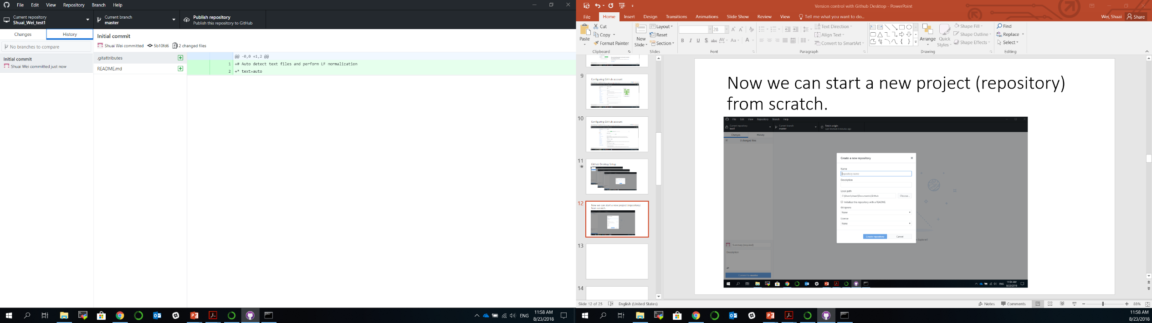
First look at the new repository by Github Desktop.

Slide 15
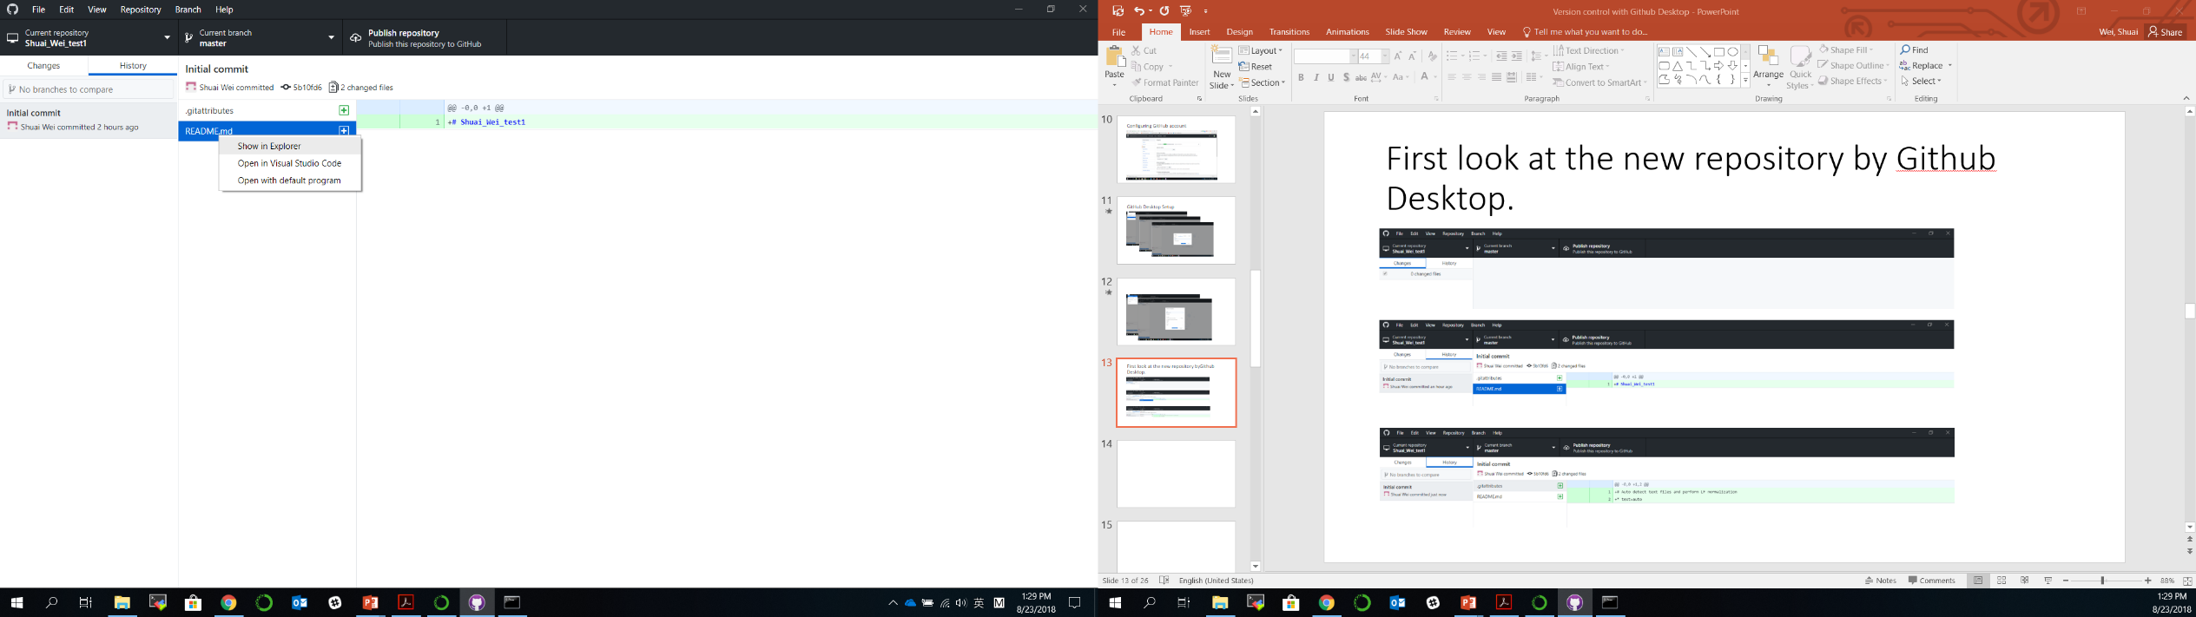
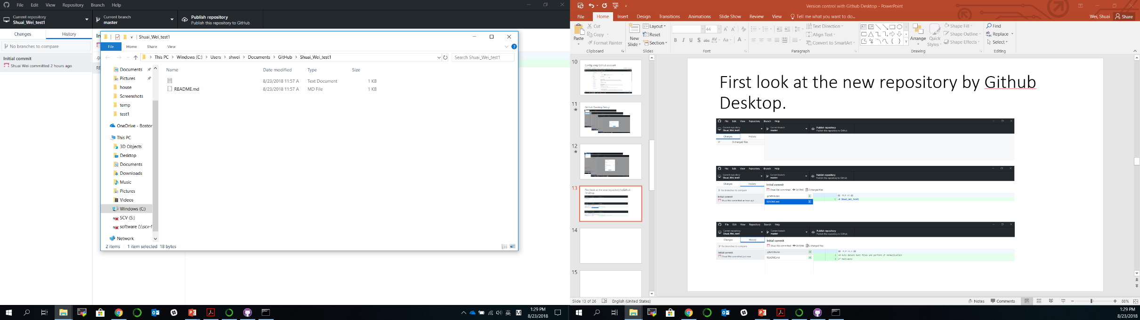
Show in folder and edit files/codes
Right click

Slide 16
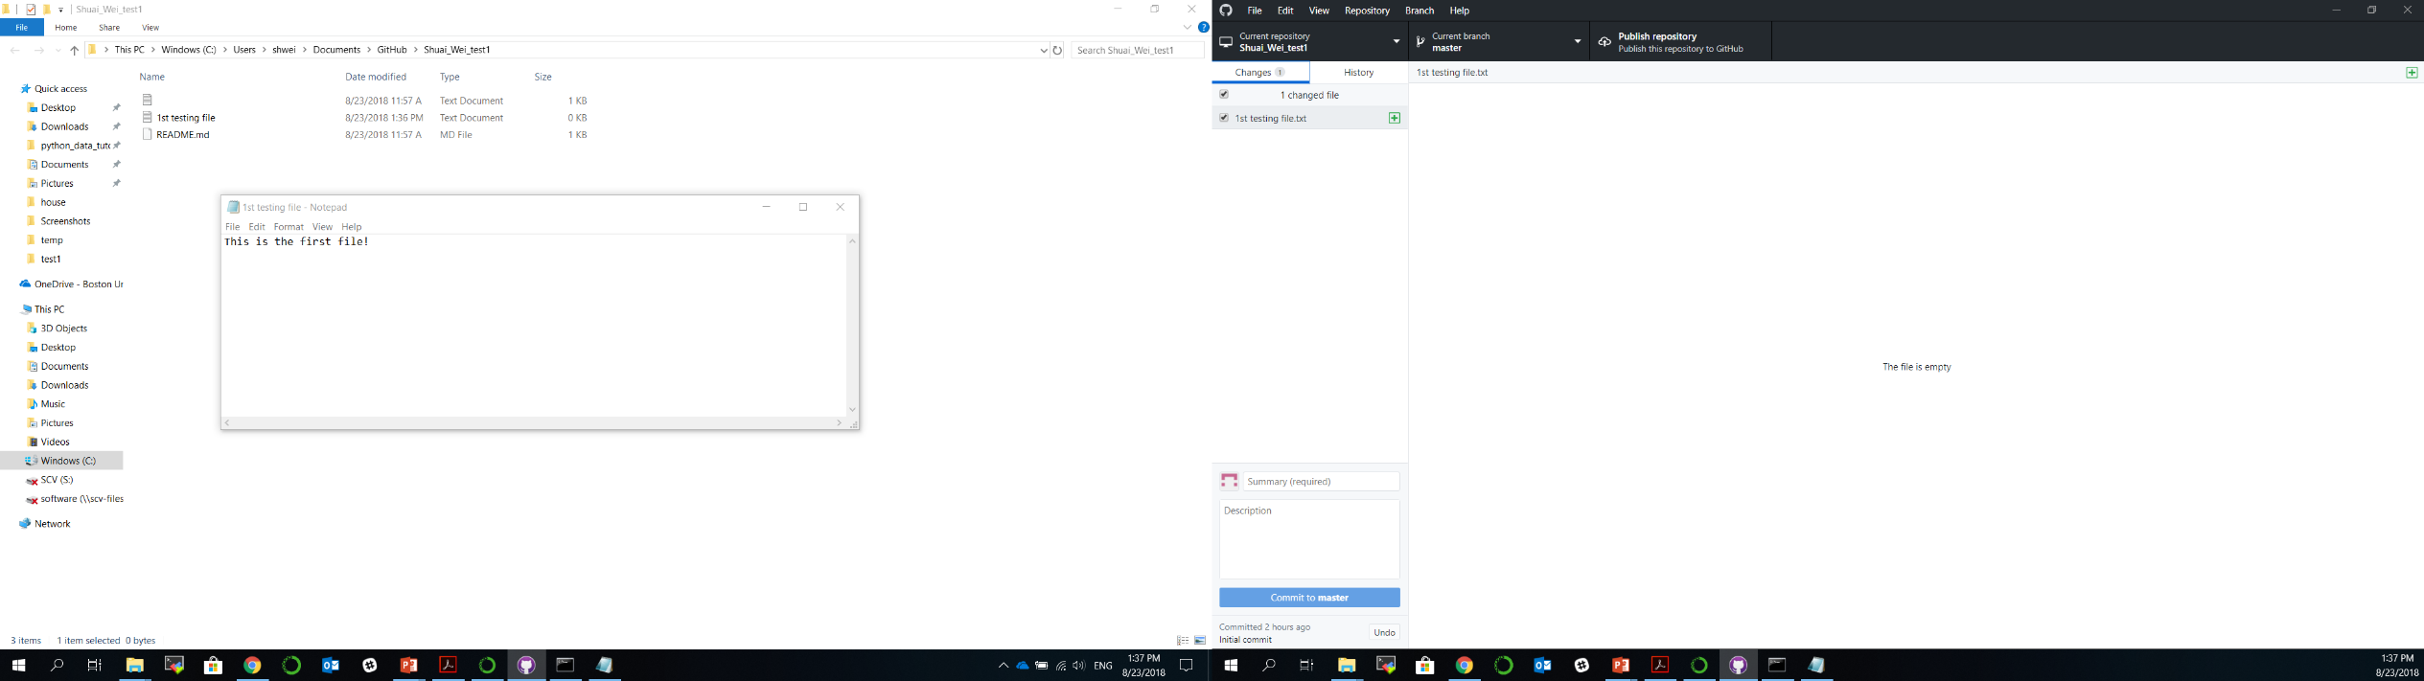
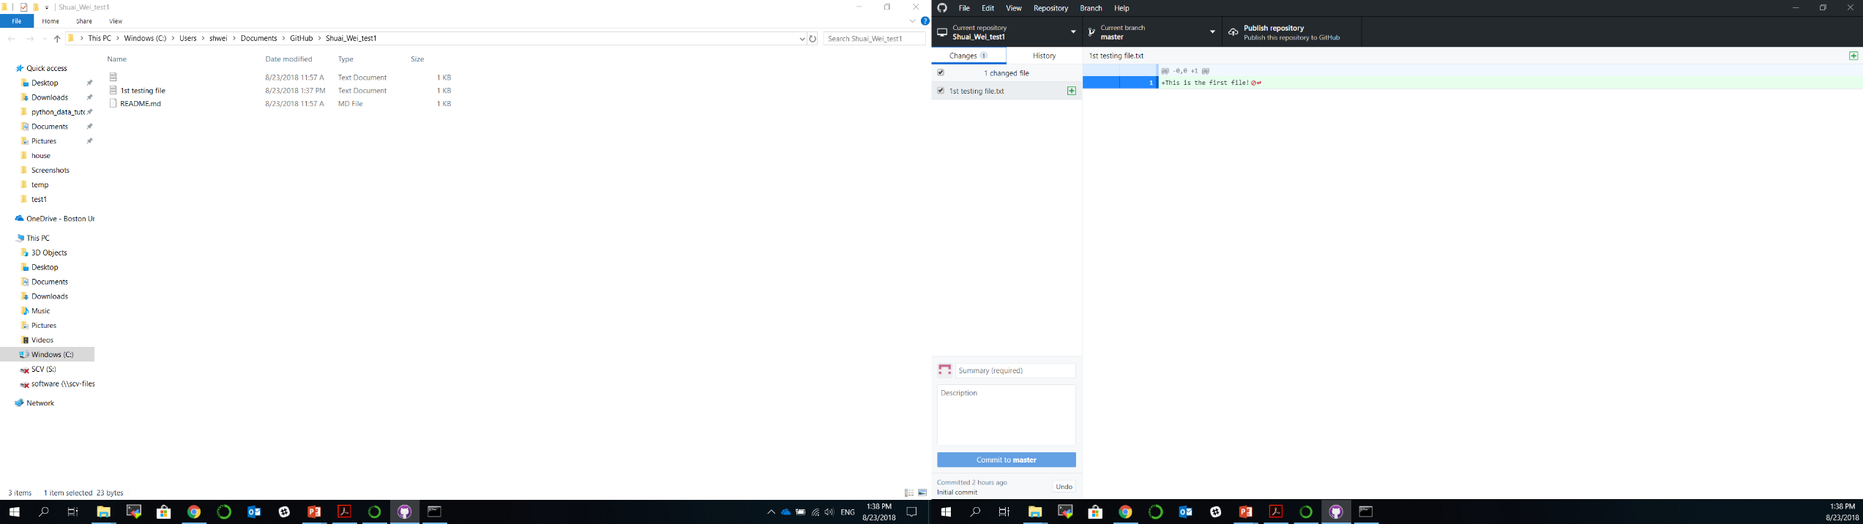

Slide 17
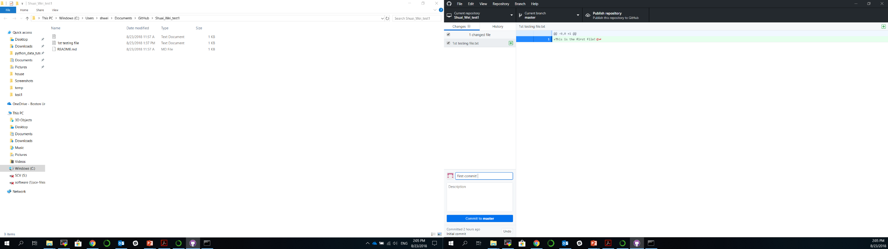
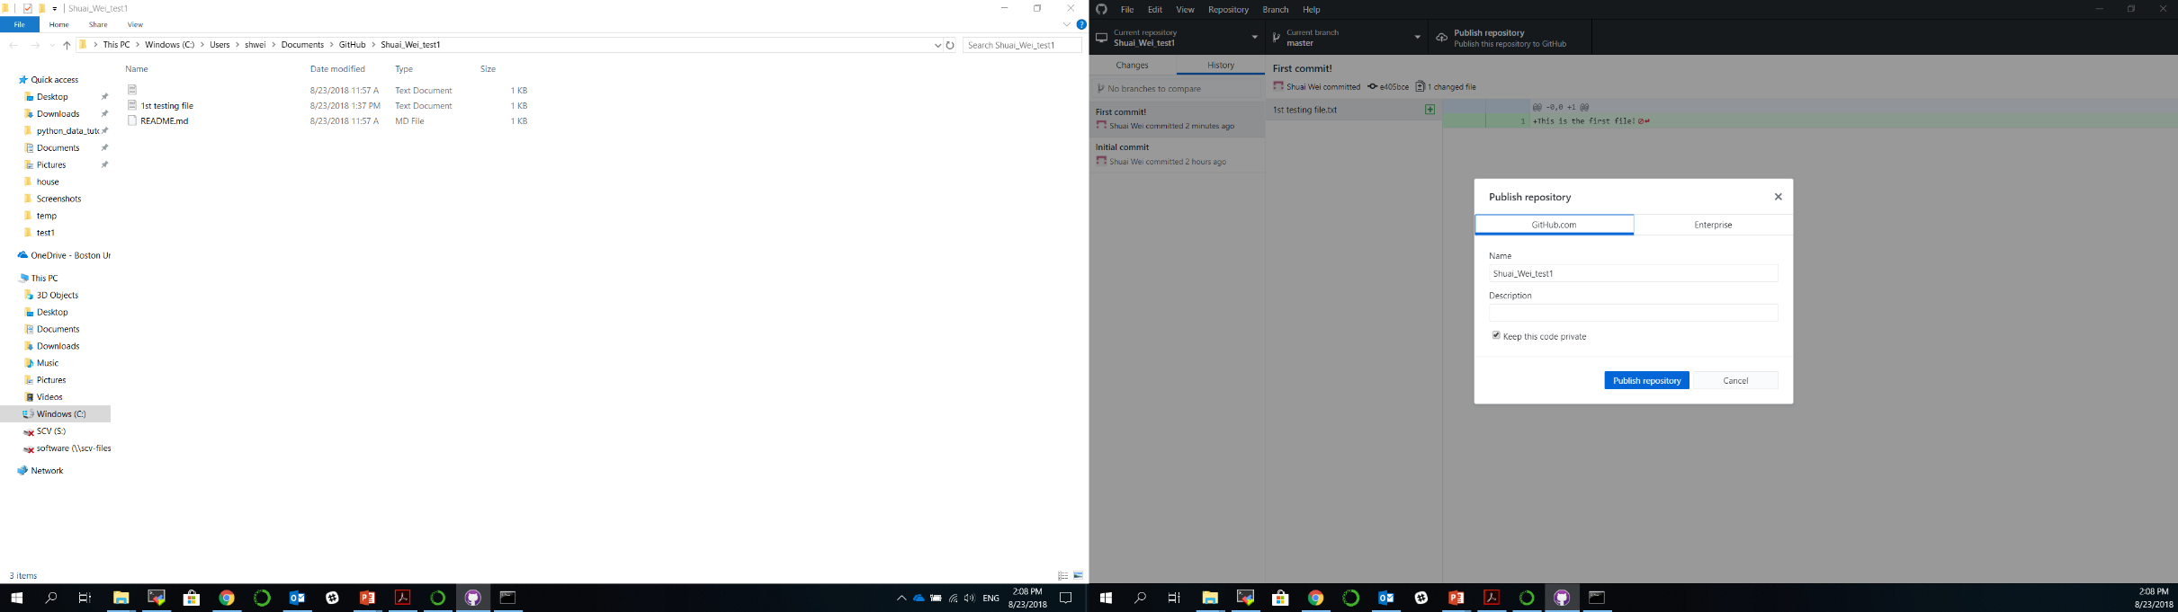
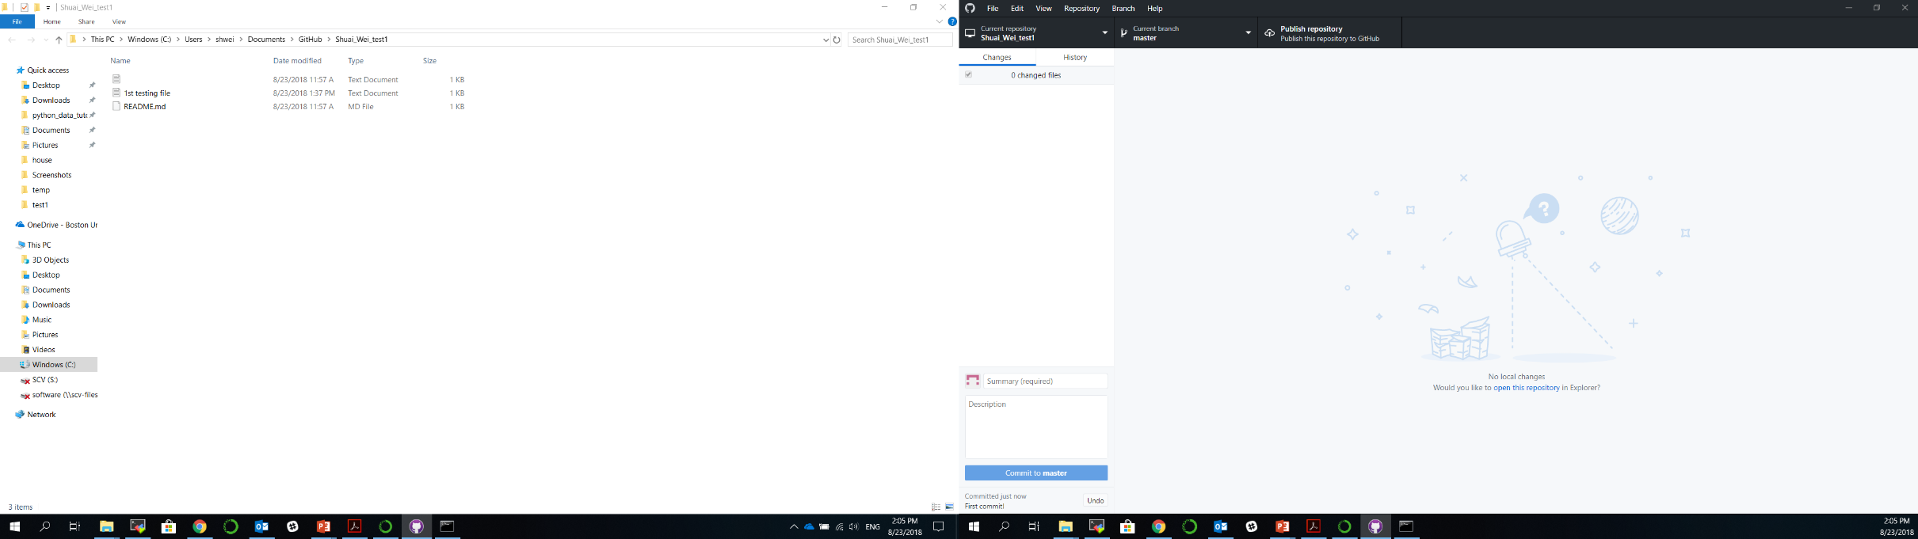
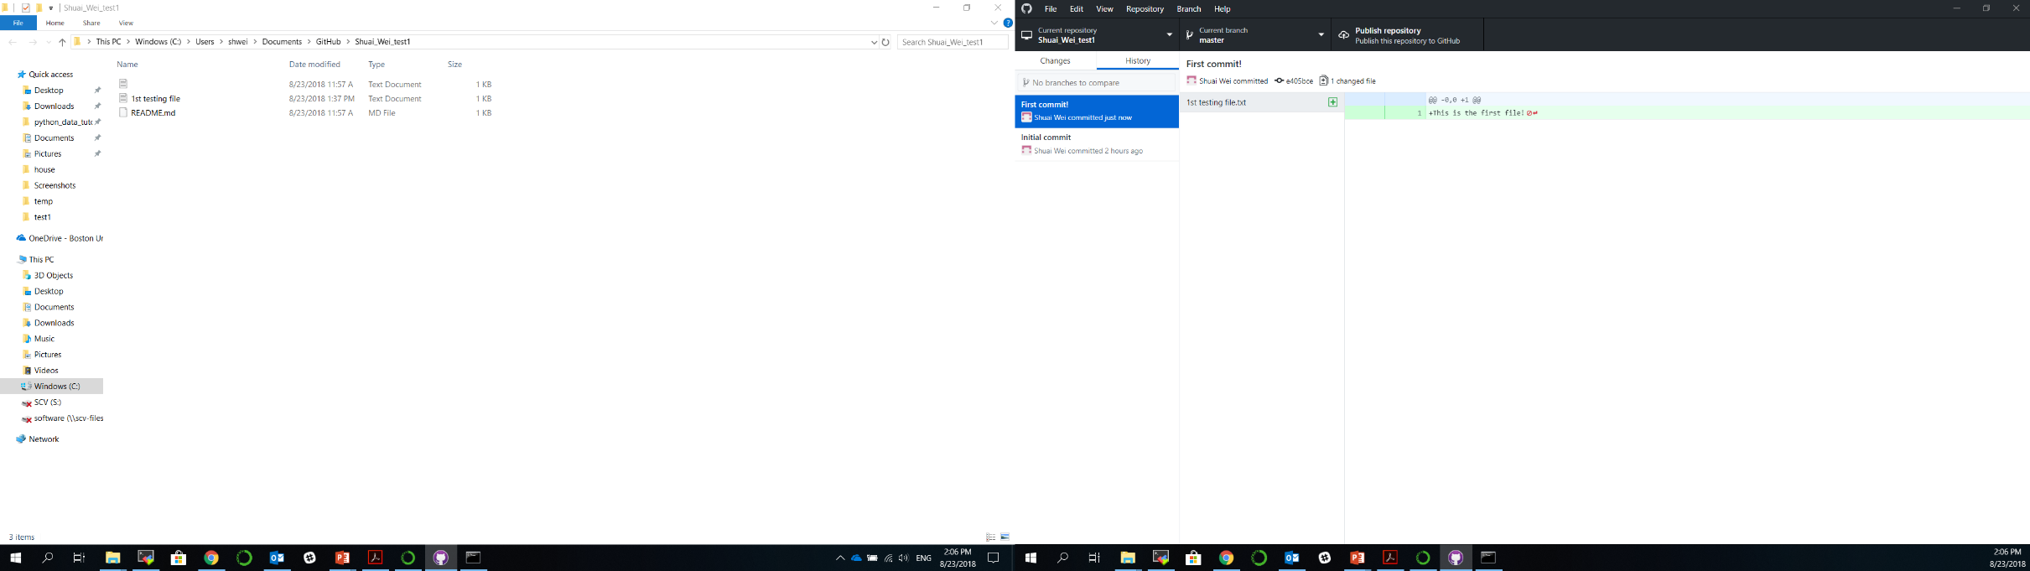
1st commit
1st push

Slide 18
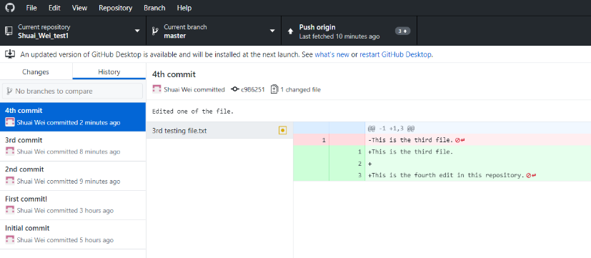
2nd, 3rd, 4th … commits and a push

Slide 19
Collaborating on a project
Authorize collaborators to a private project.
Each collaborator check out/clone a copy from the github.com repository to their local computer.
Merge back to the origin repository.
Resolve conflict with collaborators.

Slide 20
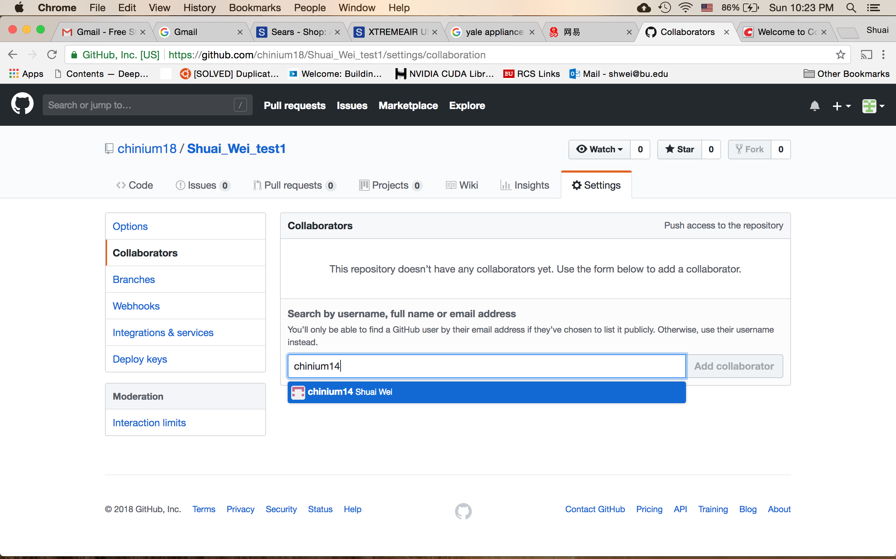
Adding collaborator to your project (repository)
Your collaborator’s github.com username

Slide 21
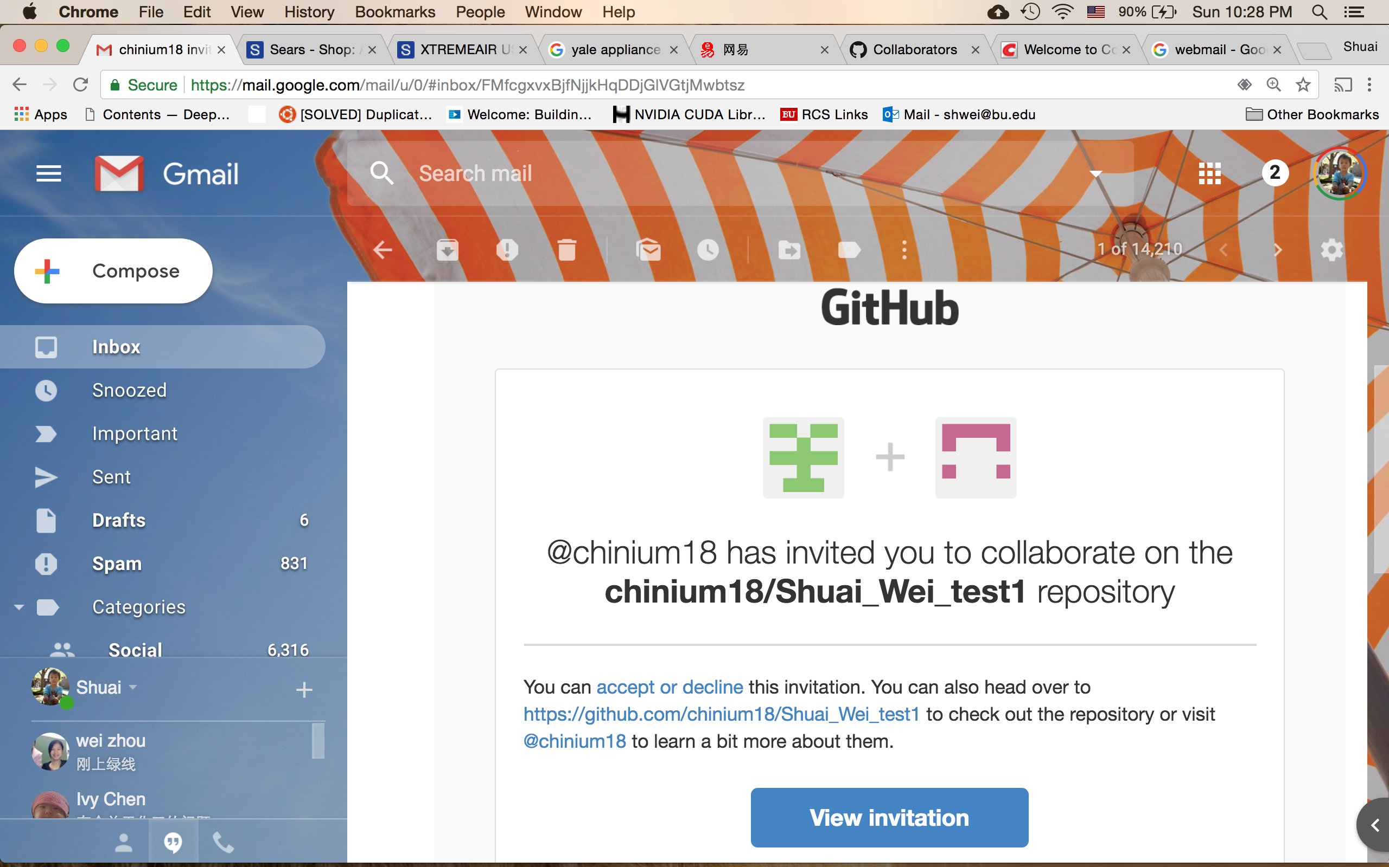
The collaborator will get an email.

Slide 22
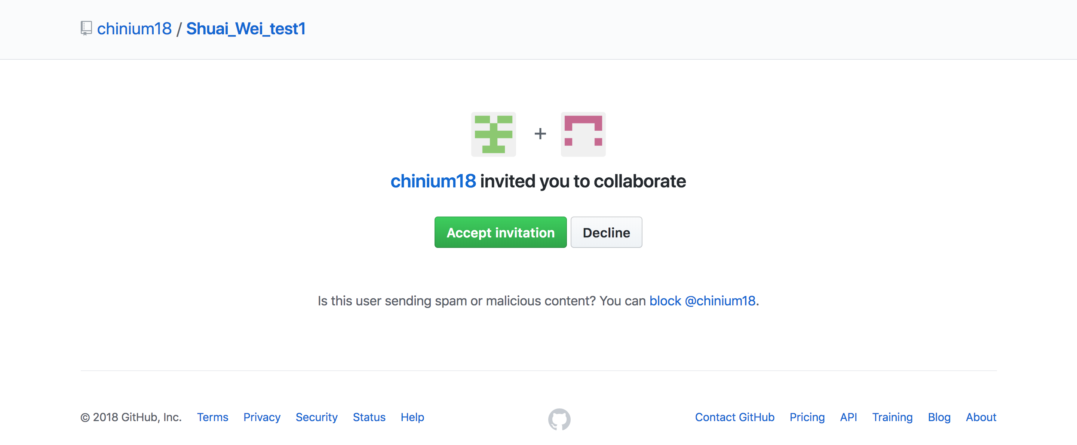
The collaborator: may check your email and find the link to this page.
Click on this button to accept the invitation.

Slide 23
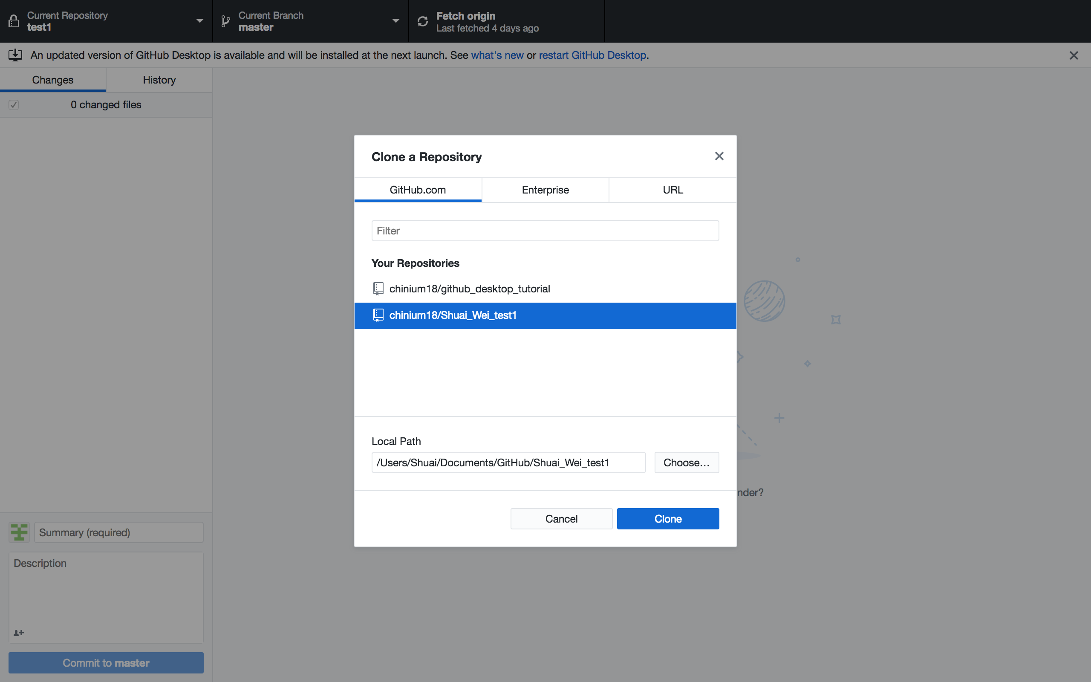
The collaborator: clone a repository from the organizer.

Slide 24
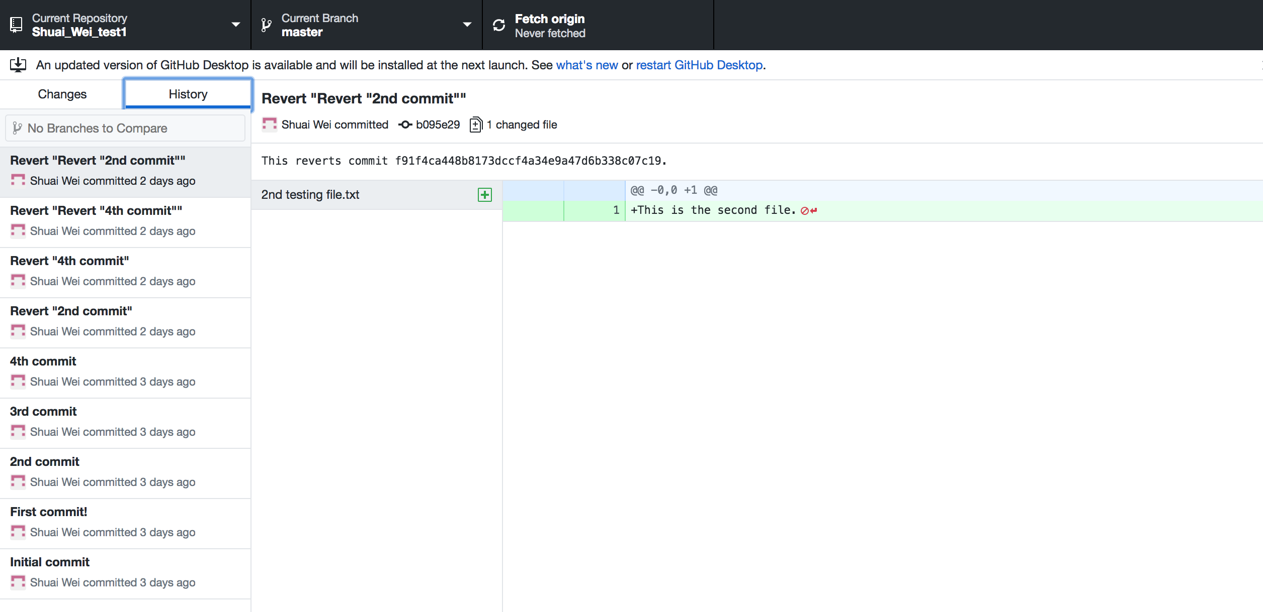
The collaborator can check out the git repository

Slide 25
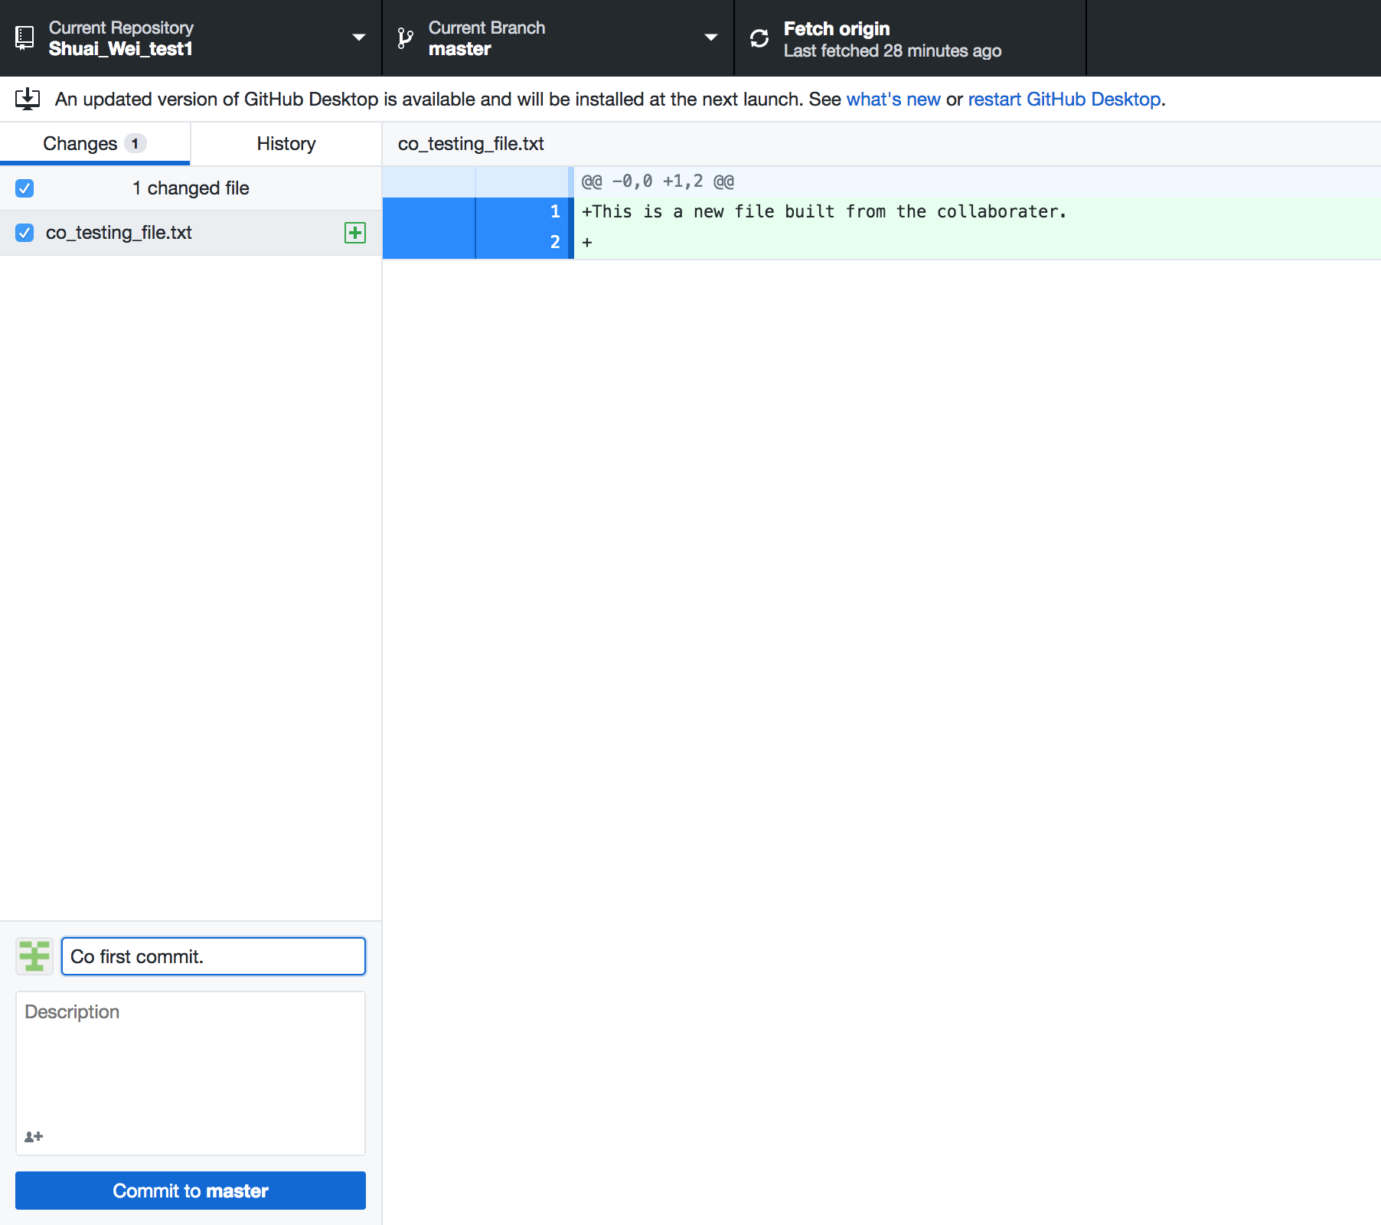
Now the collaborator can make some contribution to the repository: add a file.

Slide 26
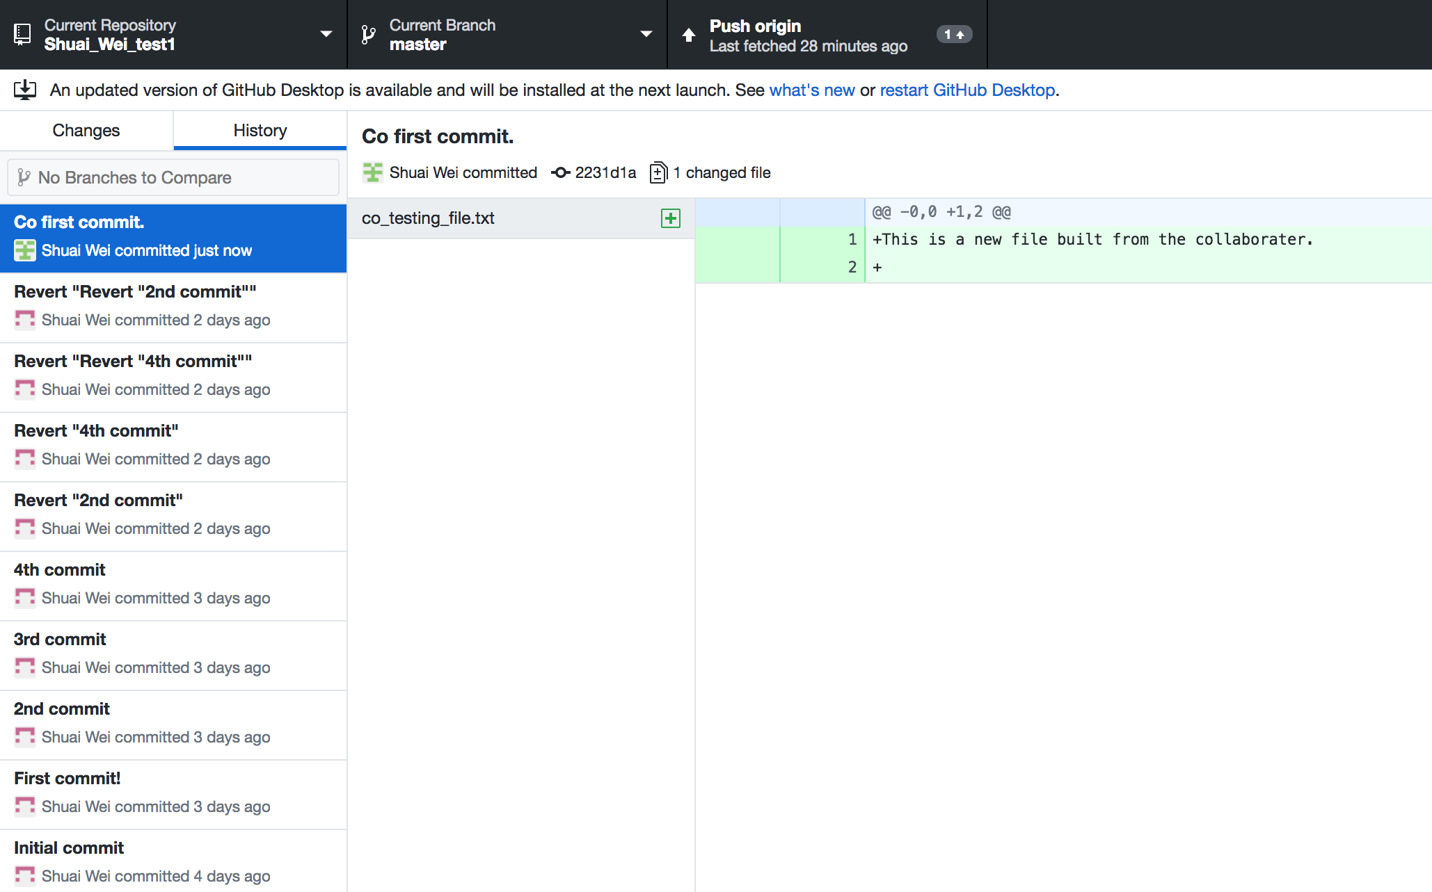
And simply push the commit to the origin repository.

Slide 27
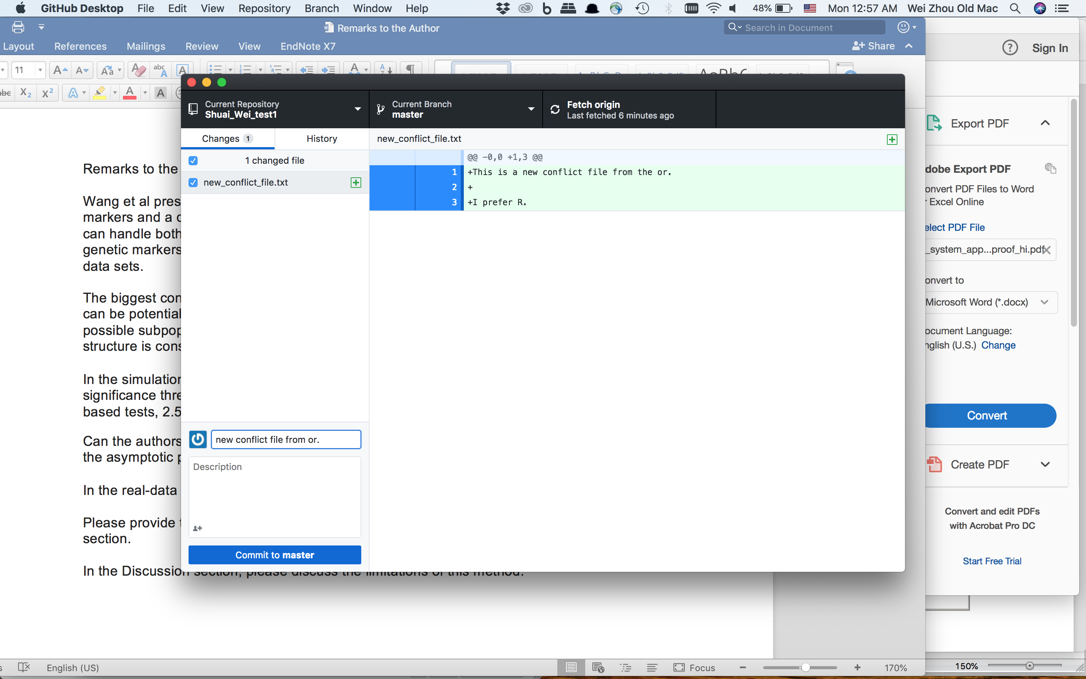
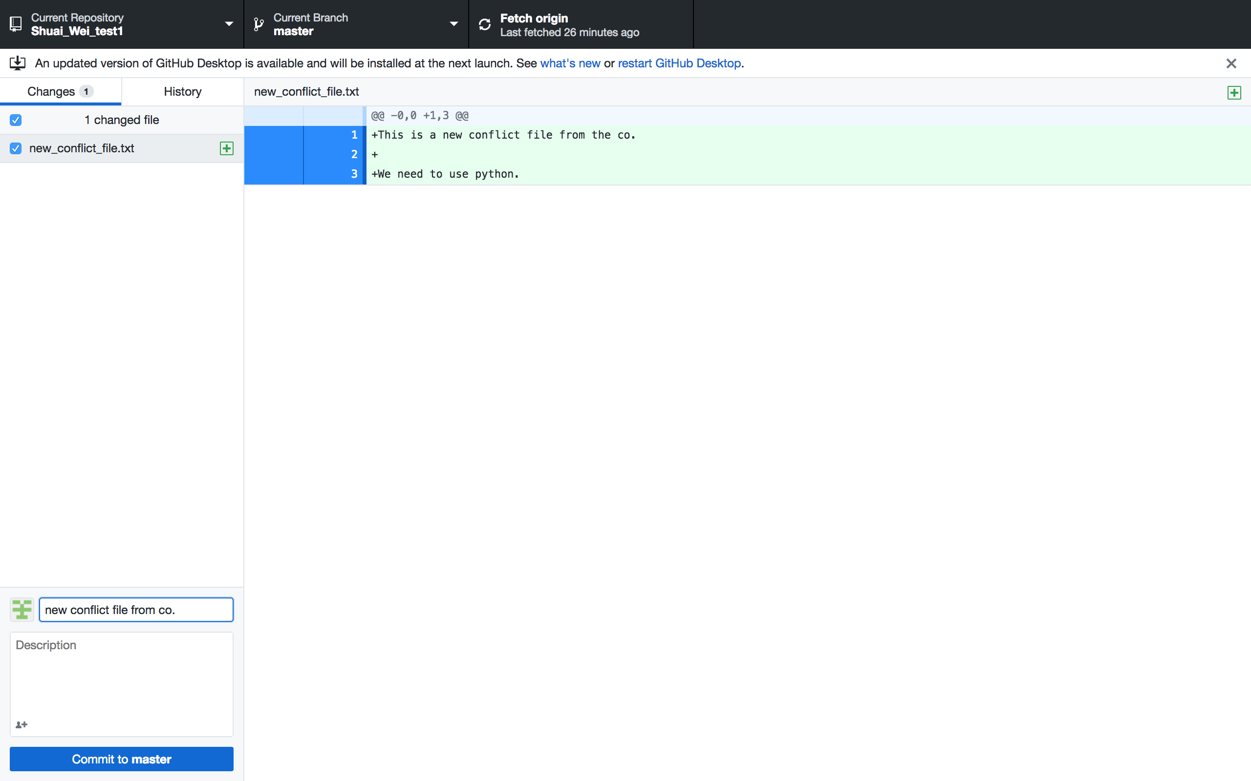
Generate a conflict between collaborators: same file name but different contents.
Conflicts here!

Slide 28
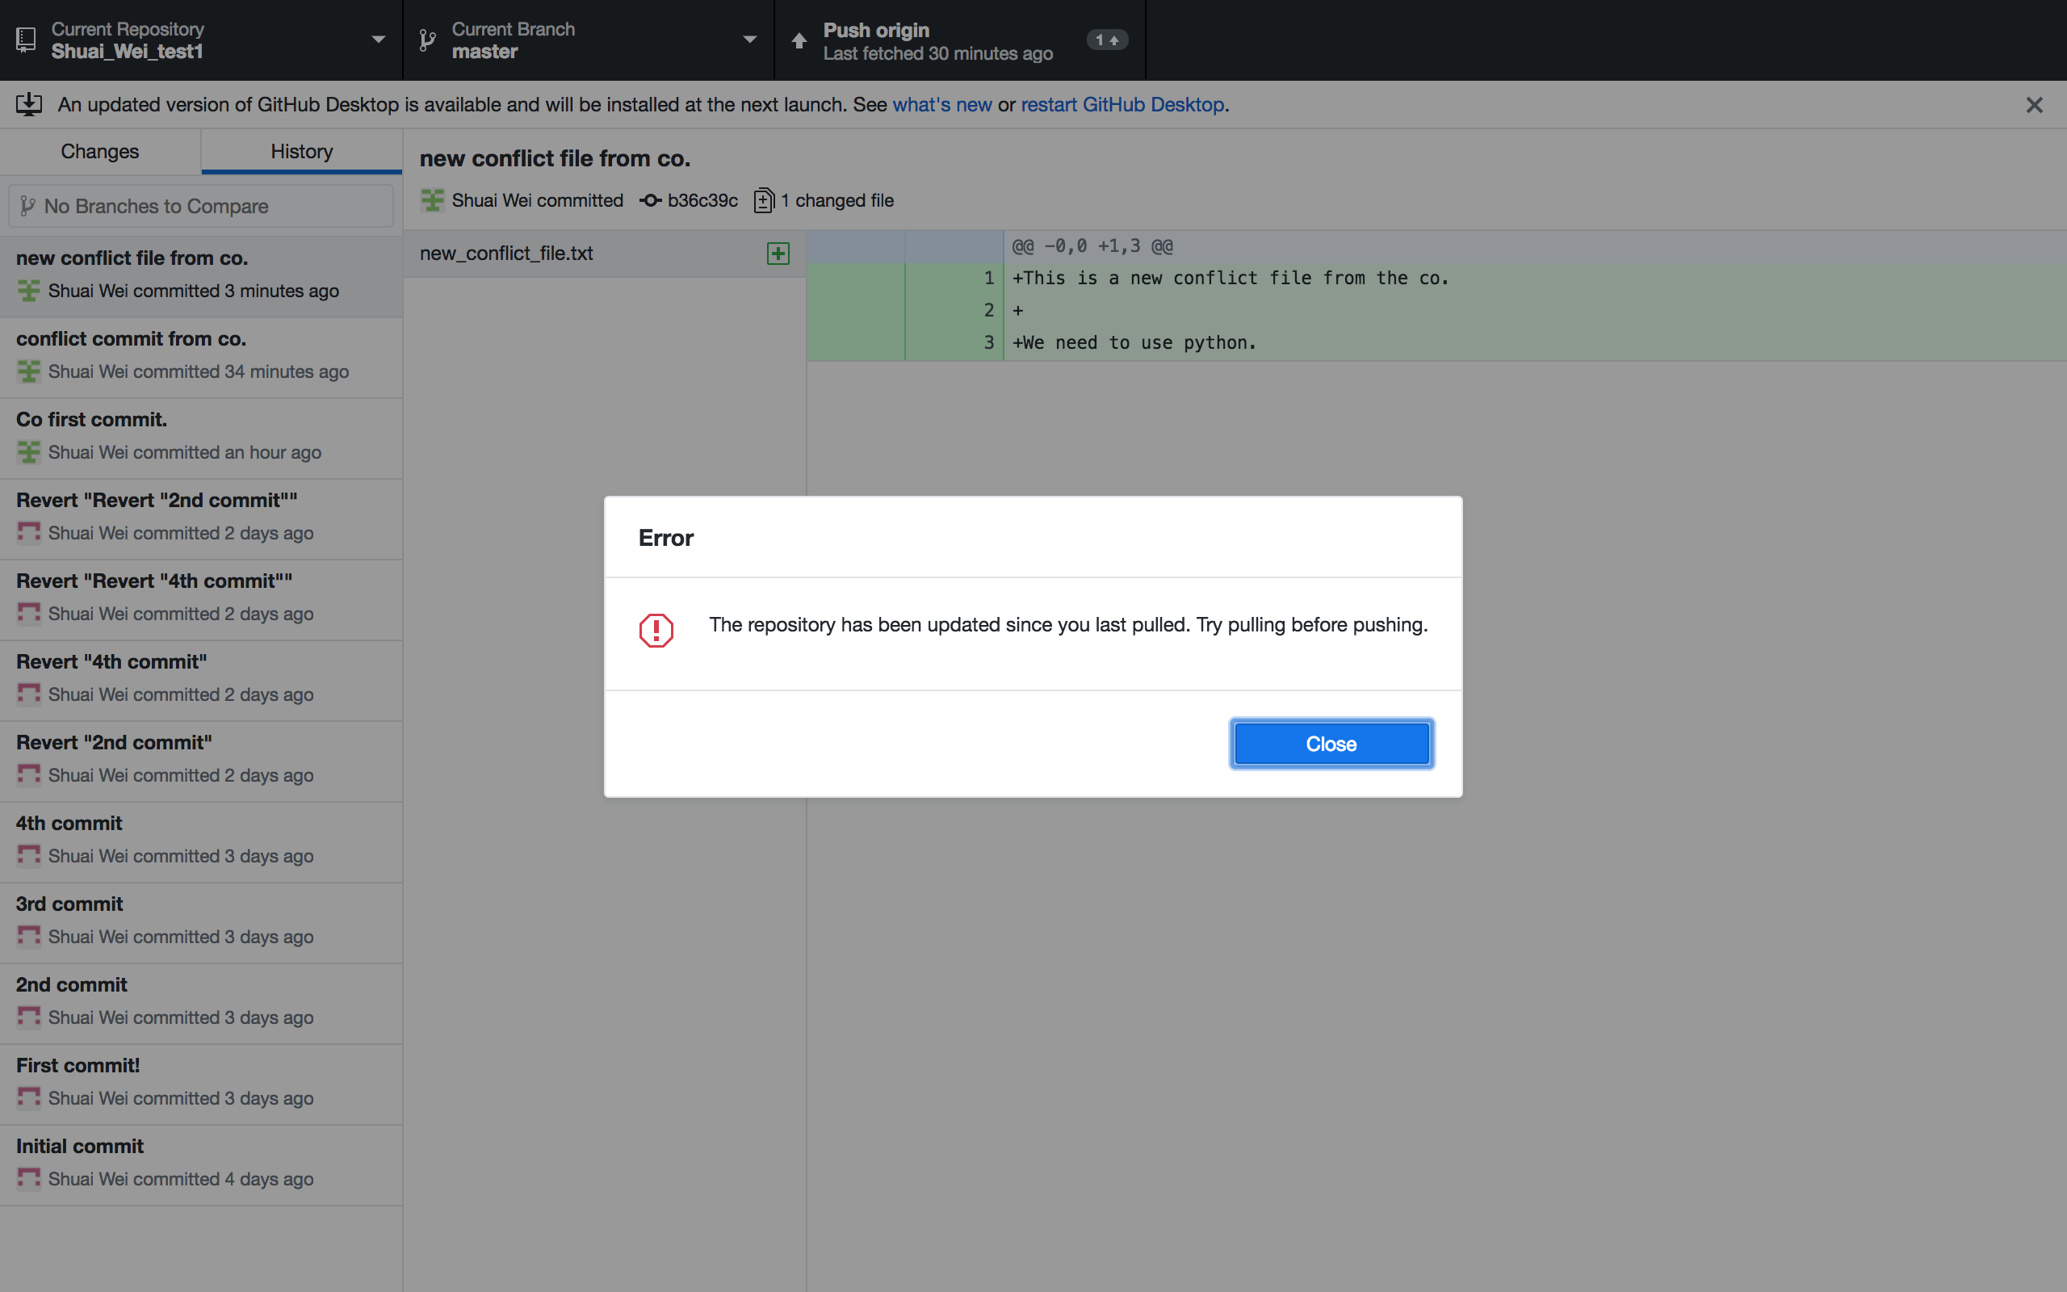
Push to the origin if you are on the latest version.

Slide 29
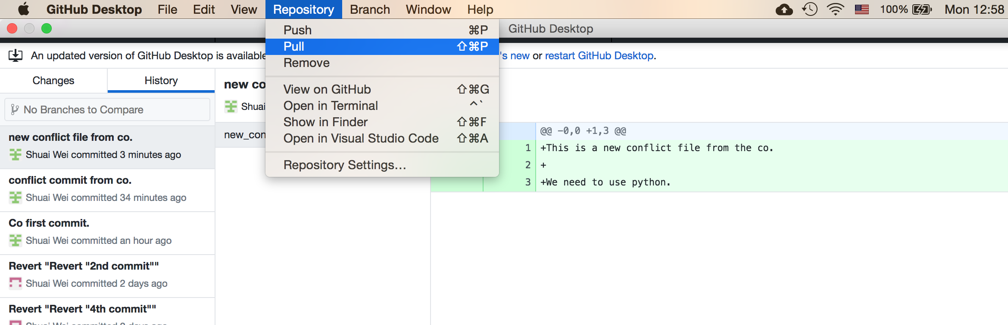
Pull the most updated version from repository

Slide 30
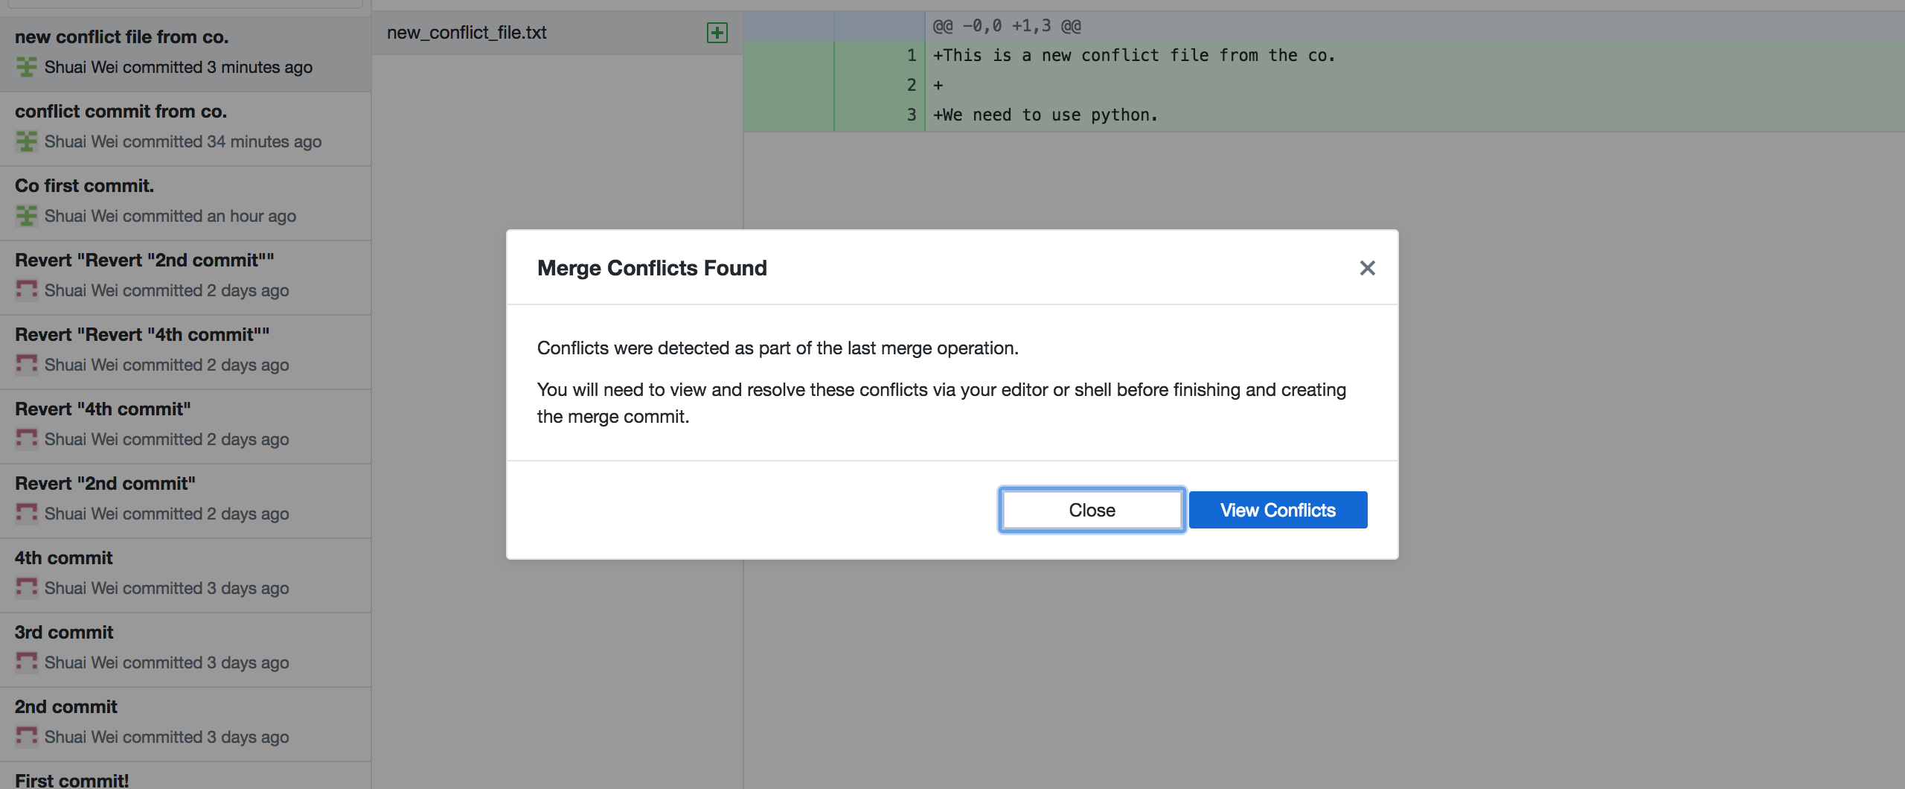
The merge conflicts found!

Slide 31
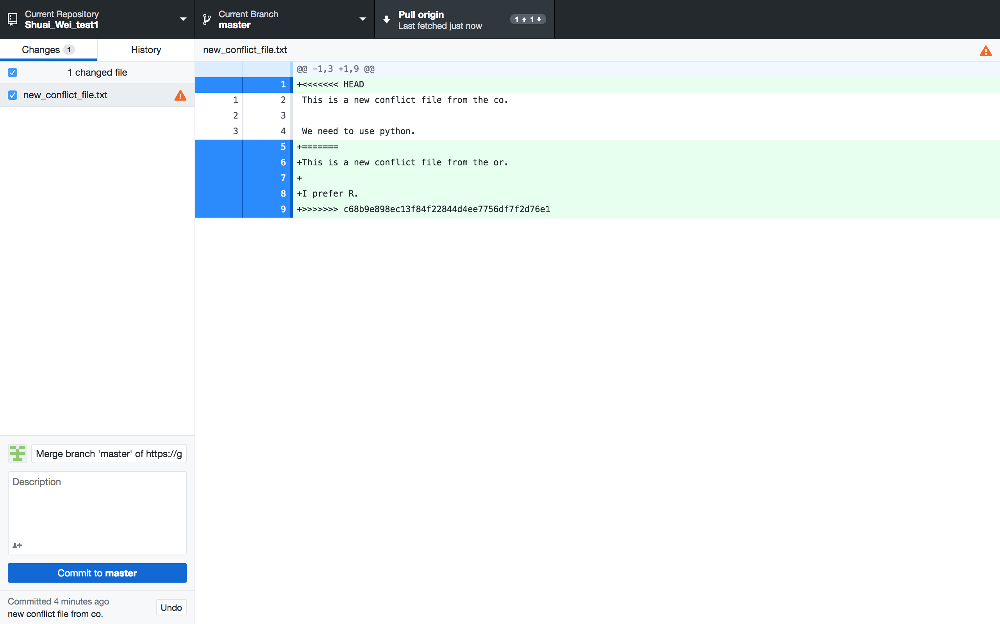
Viewing the conflict: in the file that conflicts.

Slide 32
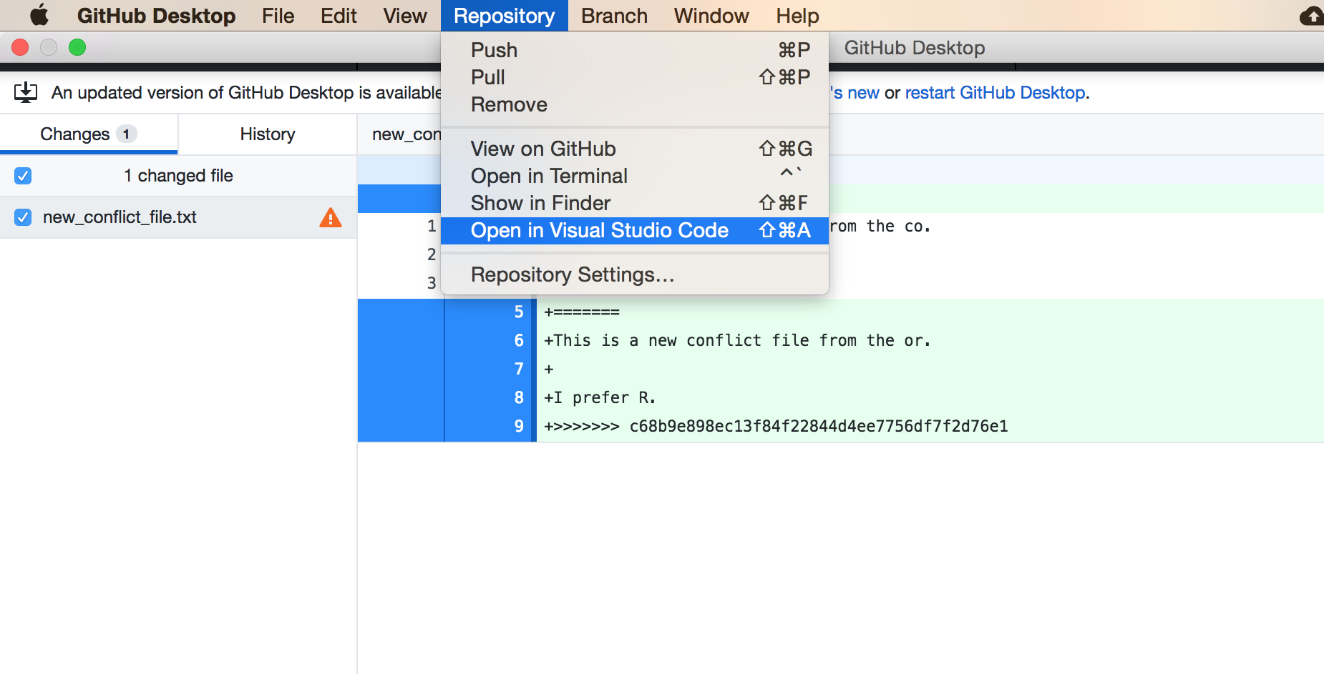
Open this file in VS Code

Slide 33
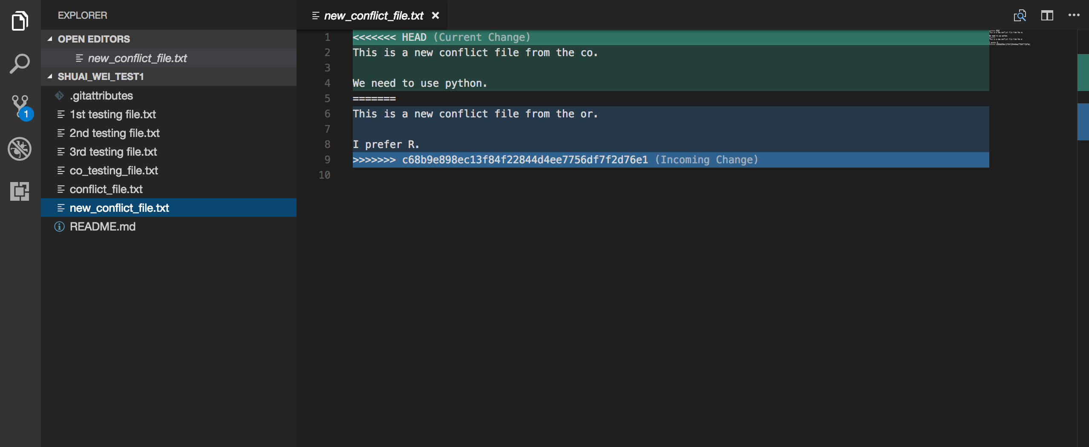
Open the file and edit it together.

Slide 34
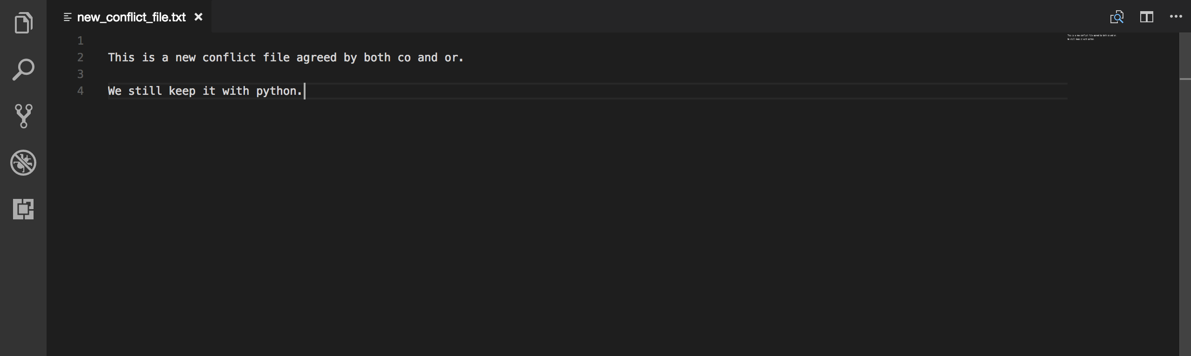
Save the file you edited.

Slide 35
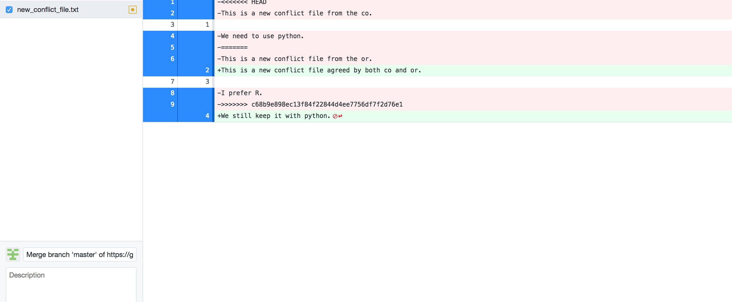
The Github Desktop view

Slide 36
Now you can commit it and push it to the origin.

Slide 37
Extras
For users who are already familiar with command lines.
Other visualization tools such as Gitk.

Slide 38
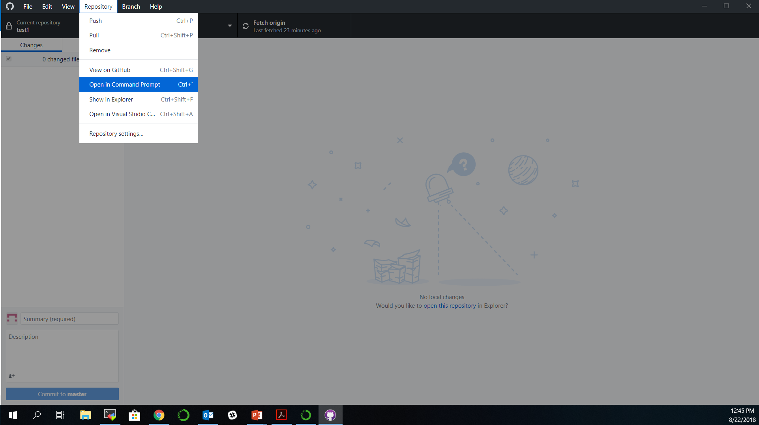
Extras: for command line users

Slide 39
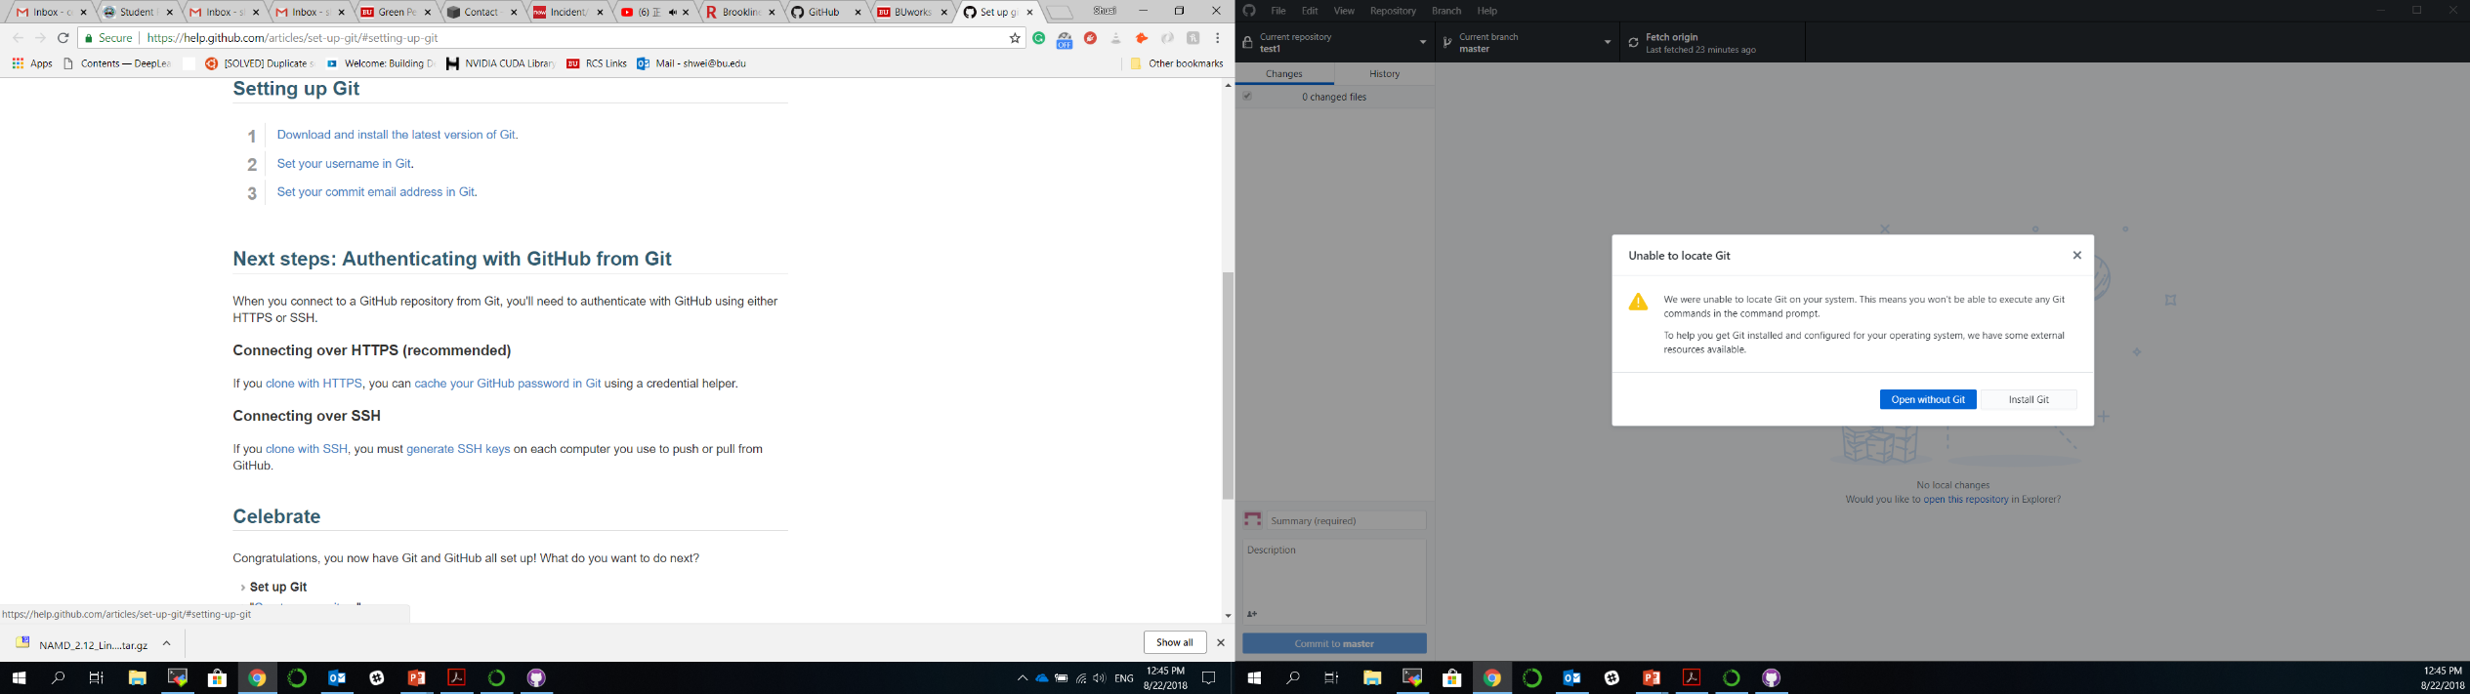
Install Git to use command lines

Slide 40
Instruction for Git setup
https://help.github.com/articles/set-up-git/#setting-up-git

Slide 41
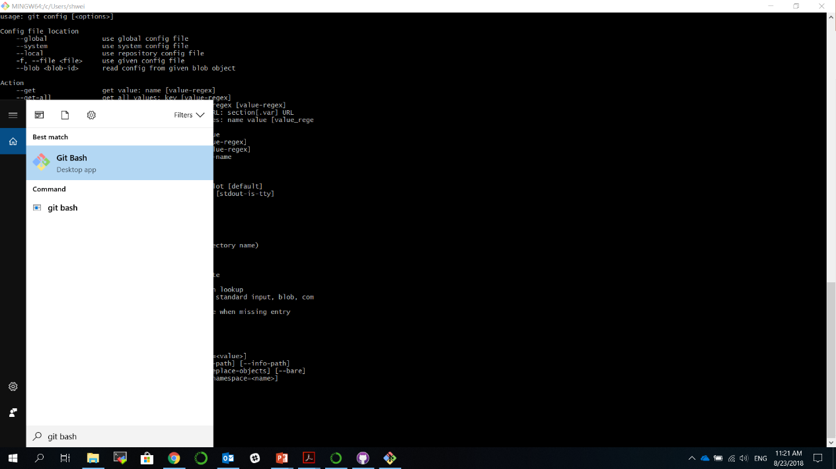
Set up Git

Slide 42
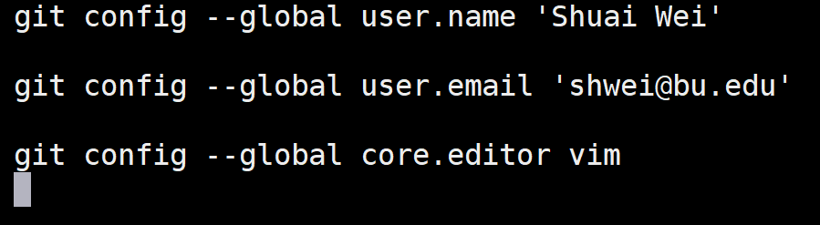
Git basic configuration
Command
Flag
Key
Value
Interpreter
program
Notes:
•Vim is the default editor used by git
•Select gedit if you are not familiar with vim or emacs editors

Slide 43
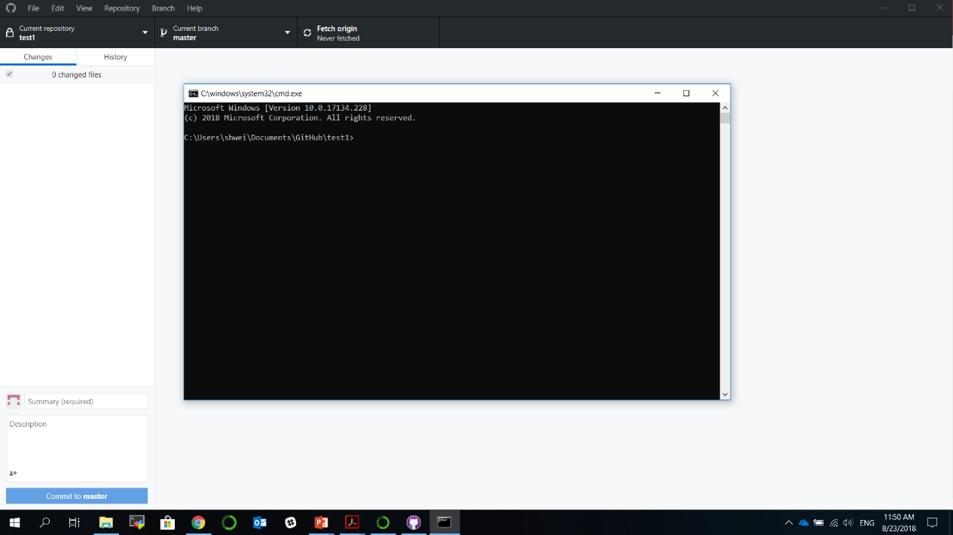
Now the command line will be available.

Slide 44
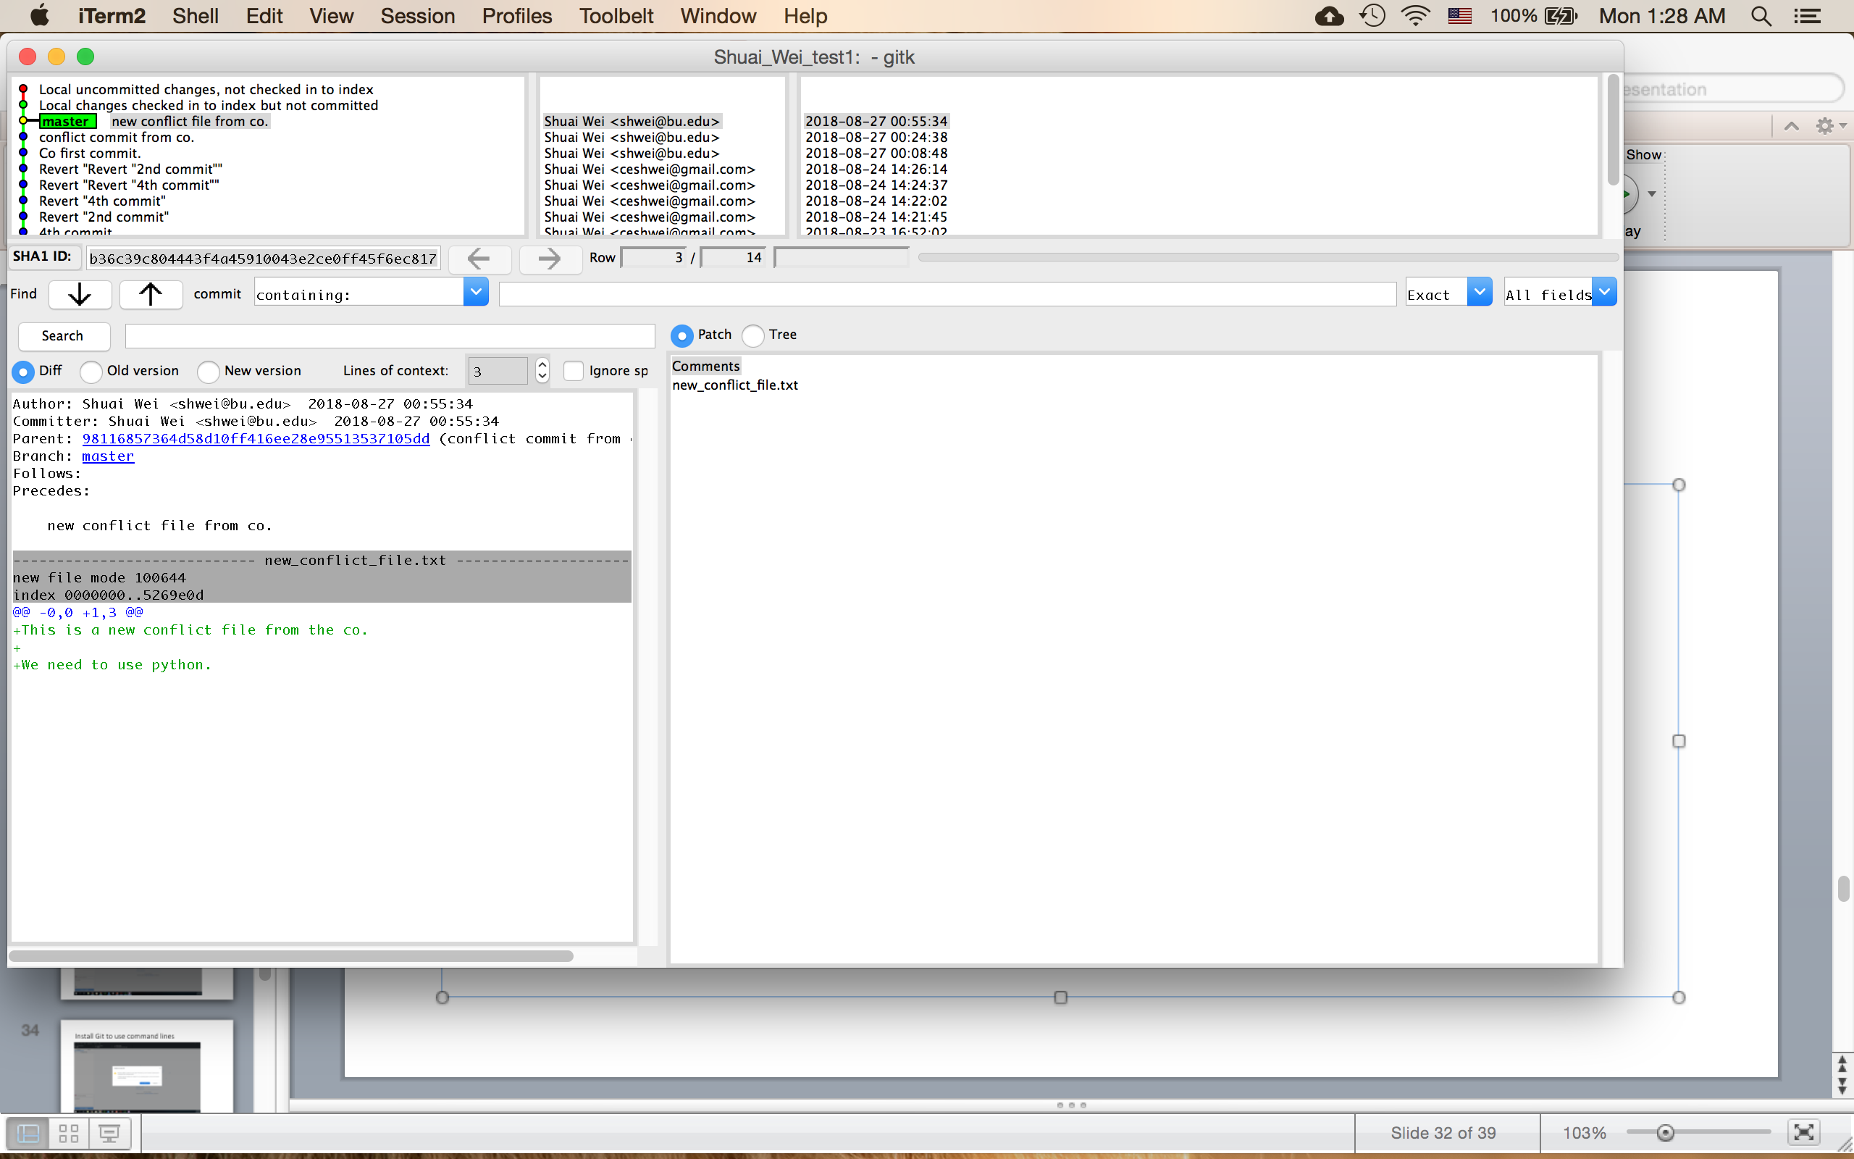
Gitk

Slide 45
Different status of files in a Git repository.

